Slide 1
Building an Enabling Business Environment
Taking Ease of Doing Business to all Nigerians
July 2018

Slide 2
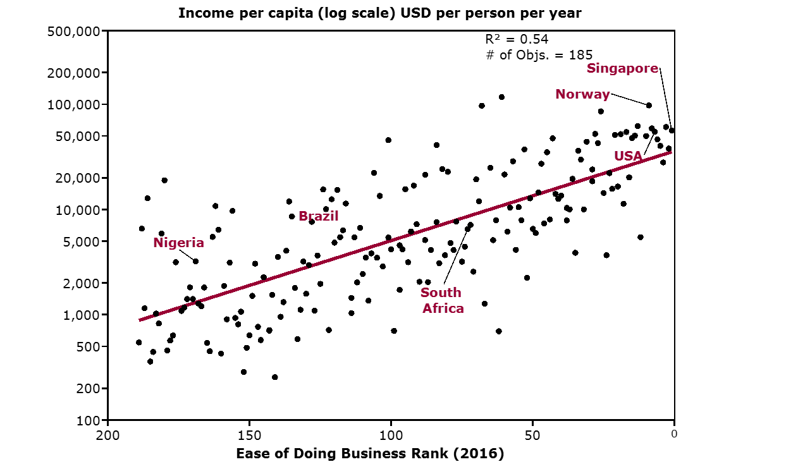
There is a strong correlation between a country’s “ease of doing business ranking” and its economic prosperity
Nigeria
SOURCE: World Bank – ‘Doing Business’ report; Lit. Search

Slide 3
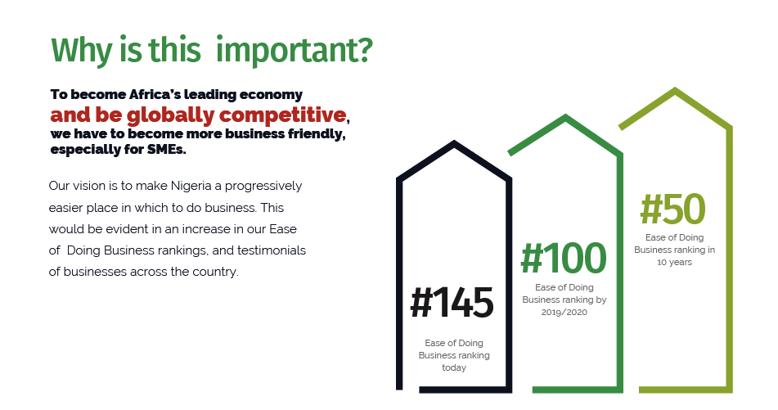
Why is this important?
To become Africa’s leading economy, and be globally competitive, we have to become more business friendly, especially for SMEs.
Our vision is to make Nigeria a progressively easier place in which to do business. This
would be evident in an increase in our Ease of Business rankings, and testimonials of
businesses across the country.
Competitiveness is the 3rd Pillar in Nigeria’s Economic Recovery & Growth Plan till 2020 (ERGP)

Slide 4
…..the country has returned to a steady recovery path, after over a decade of neglect and internal governance roadblocks
Decline
Stabilisation
Recovery
Projection

Slide 5
The Mandate
President Muhammadu
Buhari, GCFR
Vice President Yemi Osinbajo
SAN, GCON
REMOVE CRITICAL BOTTLENECKS
& BUREAUCRATIC CONSTRAINTS
to doing business in Nigeria
Move Nigeria by 2020 to
in the World Bank Ease of Doing Business Index.
Top 100
“While we are not unaware of the challenges currently being faced by our businesses, on our part, the Government remains relentless in our goal of removing the obstacles and roadblocks that have long aﬄicted commercial activity in Nigeria.”
H.E VP Prof. Osinbanjo SAN, March 2016
Email: info@ebes.gov.ng | Website: www.pebec.gov.ng | Twitter: @EBESnigeria | Facebook: www.facebook.com/EBESnigeria

Slide 6
The Structure
Council Membership
PEBEC operating model
Chair – His Excellency, Vice President Yemi Osinbajo SAN, GCON.
Vice Chair – Honourable Minister of Industry, Trade and Investment.
Members – 10 other Cabinet Ministers, Head of Civil Service of the Federation, Governor of CBN, representatives from the National Assembly and the Judiciary as well as representatives from Lagos and Kano states and private sector.
EBES – the Enabling Business Environment Secretariat, implements the reform agenda of PEBEC. EBES became fully operational in October 2016.
FEC
Forms part of National Agenda (ERGP)
Quarterly update
Council
Mandate reforms and resolve bottlenecks
Monthly reporting
Secretariat
Work with MDAs to implement reforms and escalate issues
PEBEC’s model aligns with global best practice, and includes a strong performance tracking element that ensures MDAs are accountable for reform implementation

Slide 7
Significant Progress has been achieved in past 18 Months
Starting a Business
Online name reservation
Consolidation of incorporation forms into one form (CAC.1) which can be completed electronically.
Getting Credit
Borrowers have the right by law to access their credit reports .
The operationalization of a modern, web-enabled National Collateral Registry
Registering Property
Sworn affidavit not needed for title search at land registry (Lagos)
Digitization of land records and cadastral mapping of Kano City.
Paying Taxes
E-filing of Federal Taxes.
Centralized electronic payment of all Federal Taxes.
Dealing with Construction Permits
Publicized fees, procedures and laws.
Operationalized the Lagos e-planning platform.
Trading Across Borders
Reduction of documents for export from 10 to 7 and similarly for import from 14 to 8.
Getting Electricity
Reduction of procedures for new grid connections.
Entry & Exit of People
Harmonization of four forms on arrival into one form by the Nigerian Immigration Service.
48 hour visa processing timeline across missions abroad.

Slide 8
Some Implications for Small and Medium Sized Enterprises
N2.6bn
116,000 minutes
saved by SMEs in registration costs to start business annually
of traveler time saved daily
60%
130%
reduction in time to register property
increase in SME access to credit
23,500 hours
24 place
saved by exporters annually
increase in Nigeria’s position in World Bank DB rankings
SOURCE: Source: Team Analysis, The Credit Crunch - CBN/IFC

Slide 9
Underpinning core reforms….
The Executive Order 001 was signed on May 18, 2017…
…
….and has recorded 40% performance score across its 5 main planks
Transparency
Default Approvals
MAY 18TH TO JUNE 17TH, 2017
40%
EASE OF DOING BUSINESS
Entry Experience of Travelers and
Visitors
One
Govern- ment
EXECUTIVE ORDER
E01
Ports Operations
Nigeria’s Vice President, His Excellency, Prof. Yemi Osinbajo SAN, signed an executive order on transparency and improving the business environment in Nigeria.
The Executive Order (EO1) contained far-reaching initiatives to be implemented by MDAs to improve transparency and efficiency in public service delivery
SOURCE: Enabling Business Environment Secretariat

Slide 10
From July 2017, PEBEC accelerated and expanded the initiative by focusing on three key areas…..
People: Ensure excellent customer service and mind-set changes
Transparency: Ensure easier access to information, processes, and documentation
Deepen Existing Reforms
Sub-national Reforms
Additional Reforms
1
2
3
Description: Complete pending initiatives and ensure implementation of completed reforms, including communication and consequence management
Objectives: Ensure Nigerians feel impact of the reforms and the private sector can validate reforms to World Bank ahead of the May 31st deadline to maximise gains for 2018 DB Report release in October 2017.
Description: Engage with State Governments to push state-level reforms ahead of WB subnational appraising of all 36 states and FCT in 2018
Objectives: Collaborate with States to drive reforms at the sub-national level by providing assistance with reform scoping, implementation management, and operational standardisation
Description: Kick-off of reforms aimed at improving Trading within Nigeria and start preparation for World Bank indicator reforms for 2018, including Omnibus Bill.
Objectives: Broaden reforms to include a focus on Trade within Nigeria and ensure planned reforms for 2018 rankings are included in MDA budgets for next year.
The 3 main pillars are supported by a robust operating model to
accelerate change and build capacity within MDAs

Slide 11
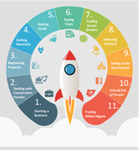
NAP 2.0: 11 reform areas were considered under the second 60-day action plan (52% scorecard)
Starting a
business
Eliminate inspection for business premises registration
Drive adoption of e-registration for company registration
Dealing with construction permits
Drive usage of the e-planning platform
Reduce cost and time to obtain development permits
Registering
property
Ensure availability of land information online
Simplify and optimize the process of obtaining the Governor’s Consent
Getting electricity
Reduce time to get connected to the grid by deploying online systems
Ensure compliance to revised procedures and timelines for getting grid connected
National Action Plan 2 (NAP 2.0)
On October 3, 2017, PEBEC launched the second National Action Plan which focused on deepening and enforcing some of the initiatives in the first National Action Plan as well as implementing new reforms.
Getting credit
Improve access to credit by driving usage of the National Collateral Registry
Facilitate usage of credit bureaus for the provision of credit data and credit scoring
Paying taxes
Simplify the process and reduce the time for paying taxes
Trading across
borders
Enable quicker and easier movement of goods across borders
Enforcing contracts
Reduce the time it takes to resolve cases related to commercial contracts
Selling to the government
Simplify the government procurement process for SMEs
Entry and exit of people
Improve the experience of travelers entering and leaving Nigeria
Decrease time spent at airports, and streamline processes for entering the country
Trading within Nigeria
Simplify the process of registering food and drugs at NAFDAC
Enforce removal of illegal roadblocks
Trademark registry to clear backlog of outstanding marks

Slide 12
Implementation of NAP 3.0 aimed to deliver significant benefits, especially for SMEs
1.3 mn
75%
MSMEs become eligible to do business with the government
Reduction in average clearance time for foreign travelers
75%
60%
50%
Reduction in time to register business premises in Kano
Reduction in time to get electricity
Reduction in time for filing Corporate Income Taxes
SOURCE: Team analysis

Slide 13
Highlights of EoDB Initiative over last 12 months
Project expanded to include the
Trading Within Nigeria indicator
Sub-national EoDB project kicks oﬀ
with all states and FCT'
Completion of NAP 2.0,
5 2 % completion rate
Release of E01 6-month report

Slide 18
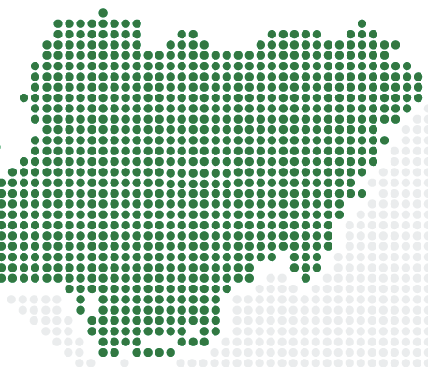
Since July 2017, Business climate reforms are also being supported at sub-national level across all 36 States and the FCT
There are compelling imperatives for sub-national reforms at the state level.
Economic growth and development aspirations
Quick Tangible Impact for Citizens
Significant Job Creation as MSMEs flourish
Healthy competition among states and regions
Eﬀective change management through efficiency; transparency; performance management; and key performance indicators (KPIs).

Slide 19
SUB-NATIONAL EASE OF DOING BUSINESS FRAMEWORK
SUB-NATIONAL TECHNICAL WORKING GROUP
Chair | PEBEC Secretary
Regional Representatives | Gombe (N.E.) Kaduna (N.W.) Niger (N.C.) | Anambra (S.E.) Edo (S.S.) Ogun (S.W.)
Organised Private Sector/Private Sector Representatives | Nigerian Economic Summit Group (NESG) National Competitiveness Council of Nigeria (NCCN) OLAM Nigeria
Public Sector Representatives | NEC Secretariat Governors’ Forum National Bureau of Statistics (NBS) Nigerian Investment Promotion Commission (NIPC) EBES (Sub-national TWG Secretariat)
STATE EoDB INITIATIVE STRUCTURE
State ExCo
Quarterly reporting
EoDB Council
Monthly reporting
Co-ordinating Officer
Notes:
Suggested operating model for states is similar to the PEBEC model to drive timely implementation of reforms

Slide 20
The sub-national Technical Working Group is developing a baseline Business Climate Survey across Nigeria’s States and Regions
Objectives | To provide a status report on the attractiveness of states in terms of business climate reforms as a reference resource for SMEs and the general business community. To showcase regional attractiveness backed up by success stories of SMEs across the states.
Methodology | State Proxy: Most commercially viable city within the state No. of Indicators: 4 Homegrown Indicators Data Sources and Instruments: Administered questionnaires; Secondary sourcing from NBS, NCCN, NIPC,…
Potential Home grown Subnational indicators
1
2
INFRASTRUCTURE
& SECURITY
TRANSPARENCY & ACCESSIBILITY TO INFORMATION
3
4
REGULATORY ENVIRONMENT
SKILLS AND LABOUR
SEP 2018: Publish the Nigeria Subnational Business Climate Report (baseline edition).
SOURCE: Enabling Business Environment Secretariat

Slide 21
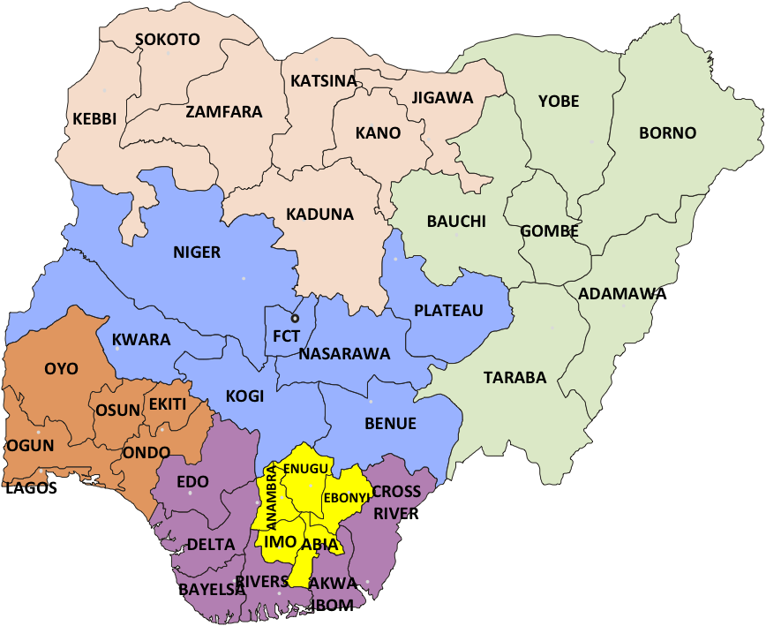
PEBEC Sub-national Ease of Doing Business - Stakeholder Engagement Guide (2016 – 2018)
North Central
North East
North West
South East
South South
South West
Held stakeholder event* in the past 12 months
Planned stakeholder event* in the next 12 months
*All state events are designed as regional events with participation from other member states of the relevant geopolitical zone.

Slide 22
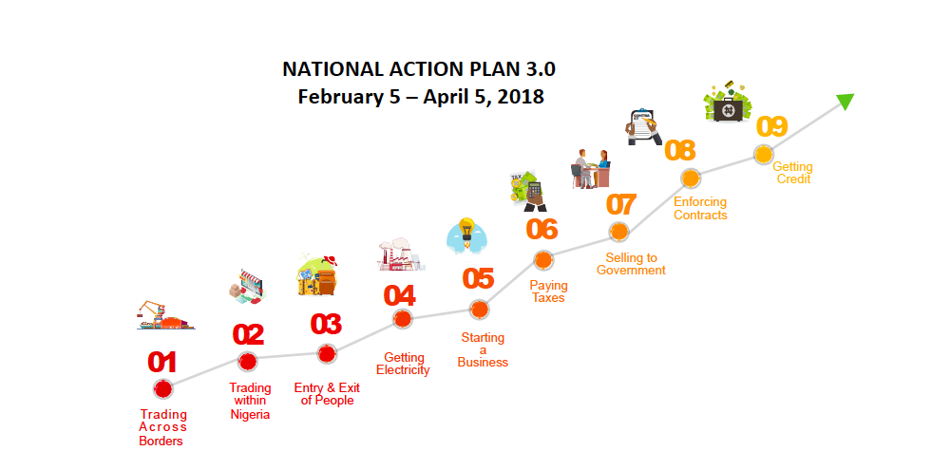

Slide 23
INDICATOR | SELECT REFORM INITIATIVES
Trading Across Borders | Clarify and implement import and export guidelines to drive efficiency at the Ports. Strengthen single joint cargo examination interface in all airports & seaports for import and export. Implement an electronic Nigerian Export Proceeds (NXP) form.
Trading within Nigeria | Clear all pending NAFDAC registration applications as at December 2017. Comply with 90-day timeline to complete NAFDAC product registration. Encourage reporting of illegal police roadblocks and institute consequence management.
Entry and Exit of People | Stop use of Passenger Service Charge (PSC) stickers. Improve Visa on Arrival process by enabling web based application and approval. Install luggage scanners at the arrival halls of the international airports.
Getting Electricity | Drive 100% compliance with NERC Order on timelines for new connections to the grid. Encourage DISCOs to roll out e-application systems for new connections to the grid. DISCOs to implement grid mapping using technology (GIS or EMS/SCADA).
Starting a Business | Adhere to timelines for post registration filings.
Paying Taxes | Communicate and enforce minimum employee requirement for pension contributions as 15 employees for government procurement purposes.
Selling to Government | Build magistrates capacity for specialized small claims commercial courts or commercial divisions in Lagos and Kano.
Enforcing Contracts | Introduce specialized small claims commercial courts in Lagos and Kano.
Getting Credit | Urge Banks to utilise the National Collateral Registry.
National Action Plan 3 (NAP 3.0)
On February 5, 2018, PEBEC launched the third National Action Plan which focused on the most impactful reforms for the Nigerian business environment.

Slide 24
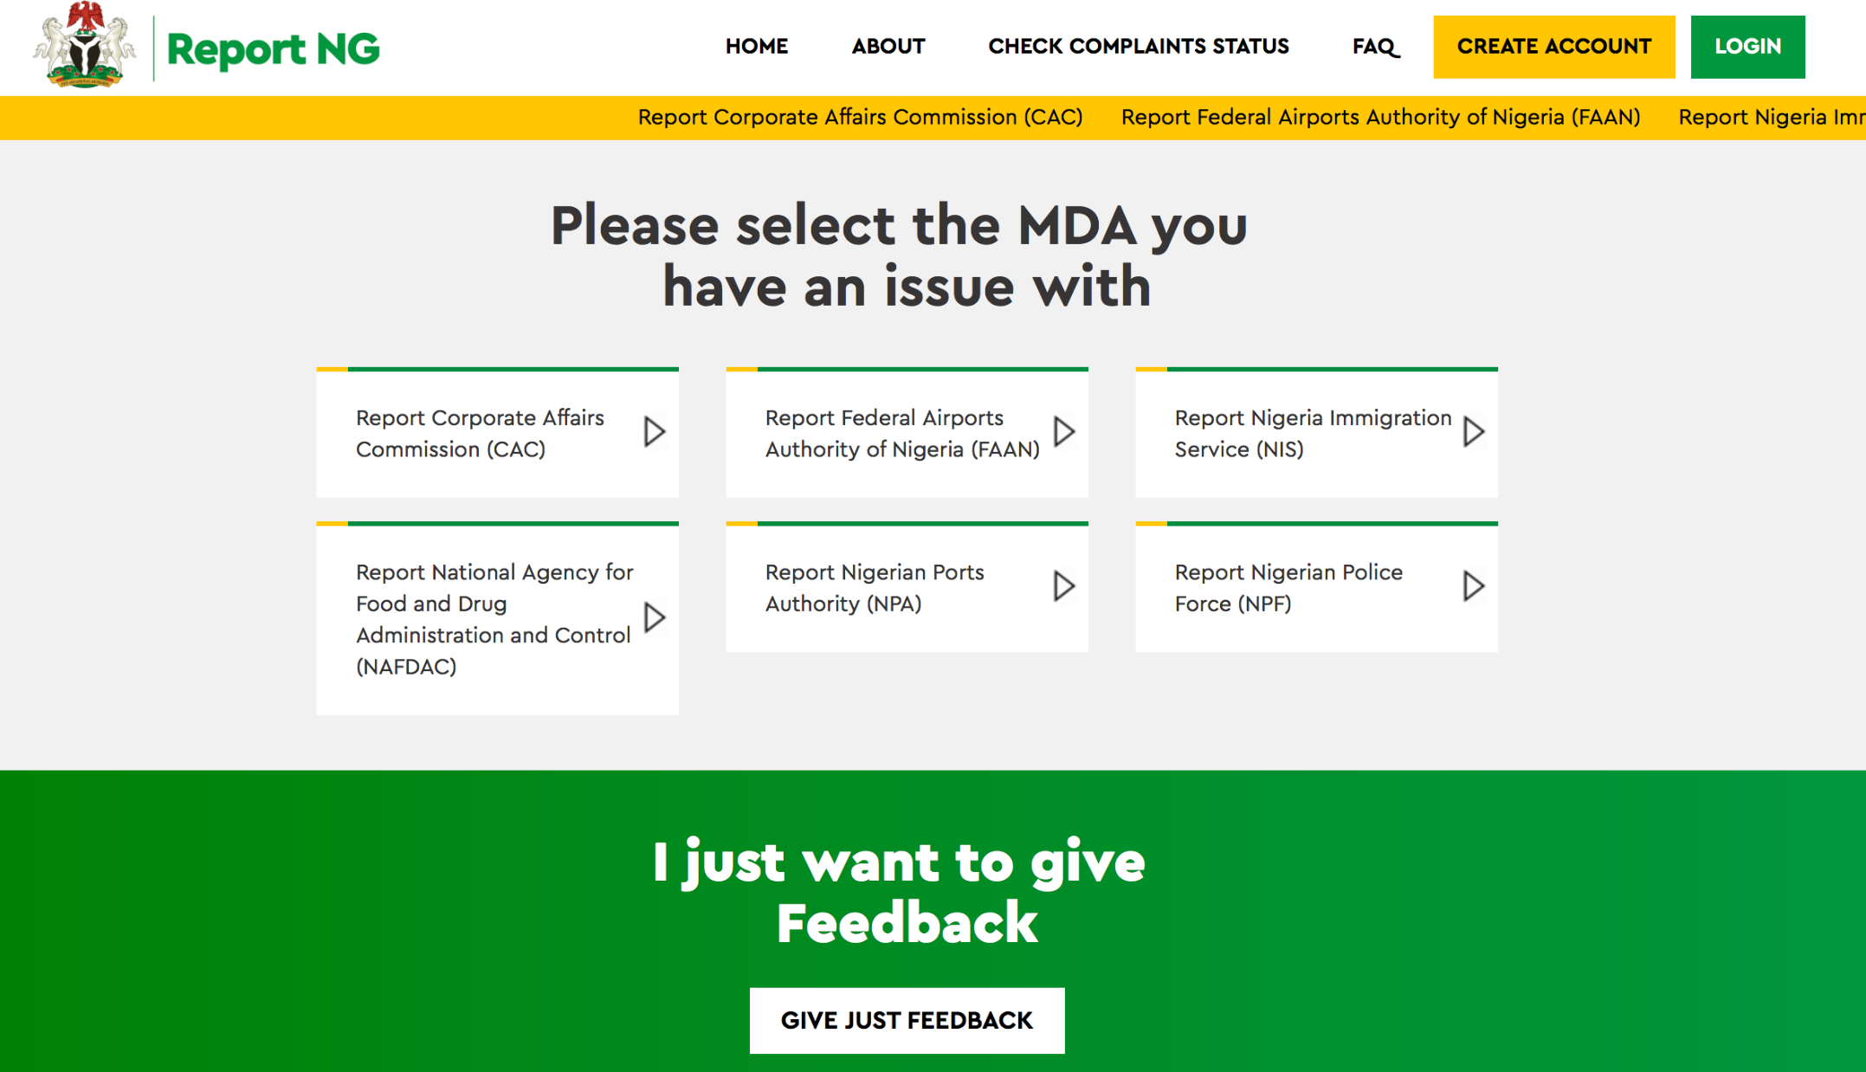
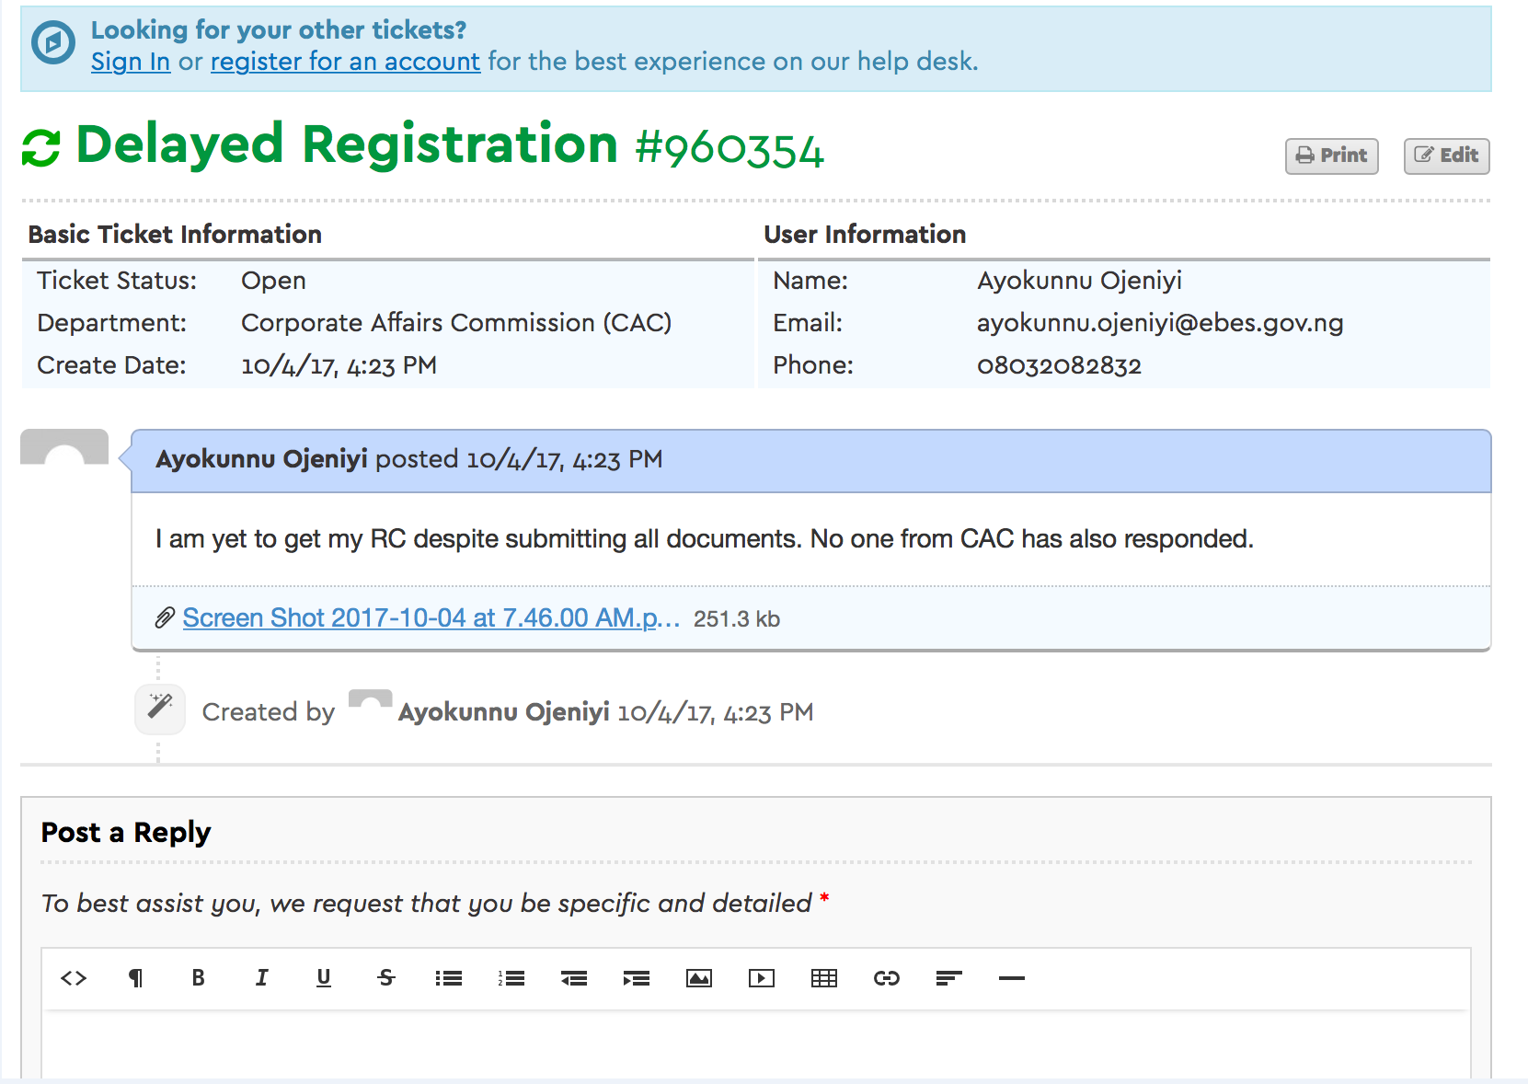
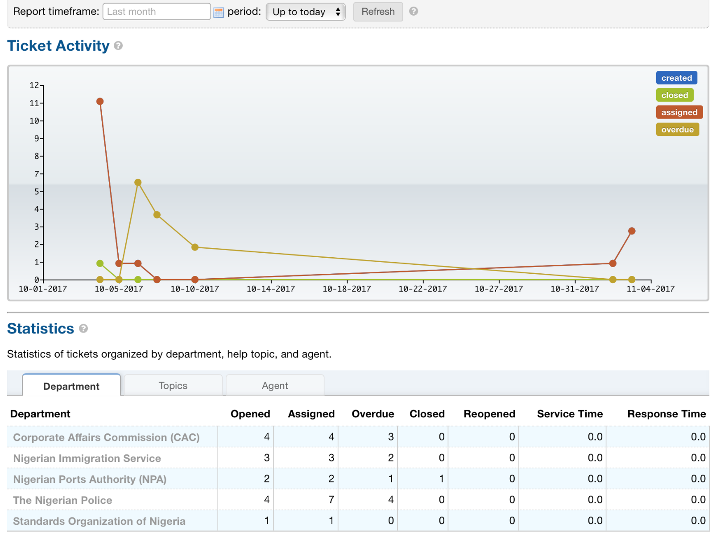
PEBEC.Report enables us obtain feedback from citizens
1
2
3
Raise tickets
Respond to tickets
Track resolution
Log a complaint by specifying MDA and provide details
MDA responds to complaints via dedicated page for each MDA
Each MDA and PEBEC/EBES have dedicated page to track the resolution
SOURCE: Enabling Business Environment Secretariat

Slide 25
Build the capacity of the Agencies to deliver
Strengthen the capabilities of the Agencies for the long-term, to sustain the improvements on an on-going basis
Strong political will and determination by the government to effect changes and improvement
Institutionalization
Foster cooperation between the ministries, Agencies and also across States, National Assembly and Private Sector
Effective coordination between all the relevant agencies to provide a unified view of implications and improvements
Proper planning to eliminate the critical binding constraints
Collaboration
Be a “moving-target” to make Nigeria a progressively easier place to do business
Means to constantly measure and monitor the improvements
Effect a hands-on implementation support for the changes and improvements
Continuous Improvement

Slide 26
PRESIDENTIAL
ENABLING BUSINESS ENVIRONMENT COUNCIL (PEBEC)
ENABLING BUSINESS ENVIRONMENT SECRETARIAT

Slide 27
Thank You
PEBEC/EBES Ofﬁce: 4th Floor, Nigeria Investment Promotion Commission (NIPC), Plot No. 1181 Aguiyi Ironsi Street, Maitama, Abuja
Email: info@ebes.gov.ng | Website: www.pebec.gov.ng | Twitter: @EBESnigeria Facebook: www.facebook.com/EBESnigeria

