Slide 1
BUREAU OF PUBLIC SERVICE REFORMS
LUNCH TIME SEMINAR
CONTRIBUTION OF DATA & STATISTICS TO REFORMING THE PUBLIC SECTOR
Dr. Yemi Kale
Statistician-General of the Federation/CEO
National Bureau of Statistics
ABUJA | MARCH 2021

Slide 2
OUTLINE
Importance of Data & Statistics
Value Creation Role of Data in Reform
Context and Challenges of Using Data in Public Sector Governance
Conclusions
Notes:
Thank you for the invitation to this lunch meeting today. The topic – contribution of data and statistics to reforming the public sector – is obviously one that I am delighted to speak about, but even more so I am pleased to see Data take center stage at such an important meeting as this meeting is. Public service reform is I’m sure one that everyone can say they are passionate about and feel is very relevant to the society. So I would like to commend the organizers for incorporating our discussion here today into the program.
Today I will begin by talking briefly on the the importance of data & statistics, then I will highlight a few examples of the value creation role that data can play in public service reform. Sharing a few examples of already existing data that can aid BPSR in its mission, then I will move on to some of the challenges we face as an organization that routinely collects and disseminates data particularly for the improvement of governance objectives, then I will round my comments up, tying together key points from the presentation.

Slide 3
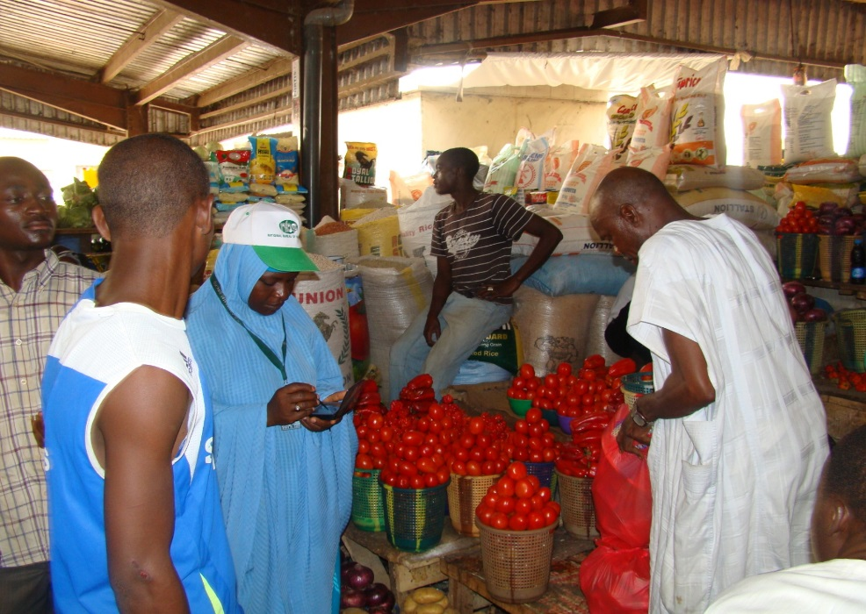
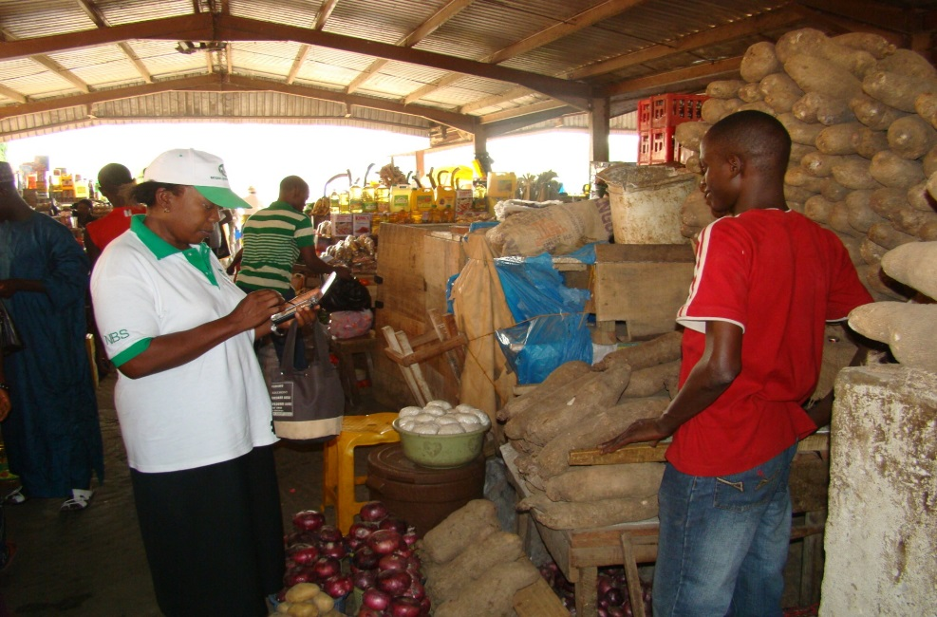
IMPORTANCE OF DATA & STATISTICS
Data plays a major role in shaping almost every aspect of human life
….they provide us with clear, objective, and numerical evidence
Population
Economic performance
Health & Wellbeing
Environment
….aids the decision making process
Helps to establish numerical benchmarks
Used in monitoring and evaluating the progress of policies or programs (such as reforms)
Helps to ensure that reforms or policy interventions are well-designed.
Notes:
Distinguished participants, we live in a global information society where the flow of data and information is constantly evolving. Data is playing a major role in shaping almost every aspect of human life, from administration to astronomy, biology to business, housing to health, engineering to environment, commerce to community, marketing to management, industry to infrastructure, politics to policy, even in sports and strategy.
Data is vital, as they provide us with clear, objective, and numerical evidence on all aspects of our lives and the state of our country, including the growth and characteristics of our population, economic performance, levels of health and wellbeing and the condition of our surrounding environment. Data aids the decision- making process by enabling us to establish numerical benchmarks and monitor and evaluate the progress of policies or programmes, thus ensuring that our policy interventions are well designed, meeting initial aims and identifying any areas which require improvement. The significance of statistical information for making evidenced-based decisions that guide the implementation of new policy, monitoring of existing policy and evaluation of the effectiveness of policy decisions cannot be over-emphasized.
Without data, we cannot make well-informed decisions that will catalyse our socio-economic development and transform the future of generations. It is when we are able to collate, understand and interpret data correctly, as well as identify key areas in our society or our economy that require change, that the policy prescriptions and direction of our governments and businesses are more likely to respond to the real needs of our communities.

Slide 4
GROWING DEMAND FOR DATA
Previously, our statistical system was:
Less than optimal
Uncoordinated with lack of access & openness
Policy makers and public sector largely ignored official data
Currently however:
There is improved coordination across government levels – federal and state – as well as across Ministries, Departments, & Agencies
Increasing recognition of the importance of statistics to measurable outcomes
Increased demand for data and for evidence backed planning and outcomes
Notes:
In the past it was difficult to meet the opportunities that improved data provides. Our statistical system was less optimal, fairly uncoordinated, and there was a general lack of access & openness. As a result policy makers and the public sector largely ignored official data. Even the general public paid little attention to the data being published, if they were published, and as such a general culture of lack of trust and unreliability became associated with the usage of data.
I am pleased to say that much of that has changed over the last several years. Currently, there is improved coordination across government levels and across ministries departments and agencies. There is also a significant increase in the recognition of the importance of statistics to national planning efforts and to measurable outcomes. NBS is often called to sit in various committees across government in order to ensure that policies are evidence-driven and that outcomes are increasingly tied to data and measurement.
Therefore the demand for data has increased tremendously and thankfully the culture of lack of trust and unreliability is being gradually reduced.

Slide 5
HOW TO USE DATA TO IMPROVE PUBLIC SERVICE DELIVERY
Data is a guiding tool -> “must have the right data at the right time”
Better reform outcomes and policy results relies on taking the right decisions at the right time, for the right reasons. All three pillars are important.
Evidence based decision making requires decision makers to actively engage with data & analysis at every point.
From initiating programs;
To allocating resources;
To monitoring and evaluating outcomes.
These are the key pillars to leveraging data & statistics for better reform outcomes and improved governance.
Notes:
A 2019 OECD report states that the key opportunities of a data-driven public sector is to aid governance, to improve design and delivery, and to support performance management.
The public health crisis and the significant shocks to the economy have increased the pressure on government to deliver better results in record time, and has increased pressure across government for efficient public service deliver.
As we all know, better policy results mean taking the right decisions at the right time, and for the right reasons. All three pillars are important for success. It means having the right guiding tool – i.e. the right data at the right time. However, having “the right data at the right time” is only part of the story. Evidence-based decision making requires decision makers to actively engage with data and analysis at each point, within the policymaking process from initiating programs, to allocating resources, to the monitoring and evaluation of outcomes. This is what we mean by leveraging data for better reform outcomes and improved governance.

Slide 6
VALUE CREATION THROUGH DATA – RECENT EXAMPLES
Corruption Trends Survey conducted in partnership with UNODC.
2nd survey in series which shines a light on the prevalence of bribery and other forms of corruption in citizen’s engagement with the public sector.
1st version in 2016 was the first comprehensive nationwide survey to be carried out in Nigeria.
Most recent version (2nd) interviewed 33,000 people, representative from each 36 states of the country.
Adults – 18 and over, one randomly selected adult interviewed per selected household
Notes:
With all that being said, I wanted to take the opportunity today to highlight two recent surveys that are available and might be useful to the work of the BPSR. First is the of the latest Corruption Trends in Nigeria survey, which the National Bureau of Statistics executed in partnership with the UNODC. This is the second survey in this series which shines a light on the prevalence of bribery and other forms of corruption in citizen’s engagement with the public sector.
The 2016 survey was the first comprehensive nationwide household survey on corruption to be conducted in Nigeria, covering all states and geopolitical zones. Same methodology & coverage used for the 2019 survey and around 33,000 persons were interviewed, representative of each of the 36 states in the country.

Slide 7
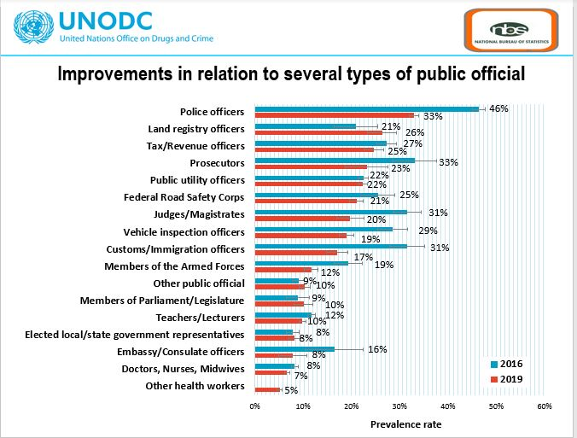
VALUE CREATION THROUGH DATA – RECENT EXAMPLES
Some highlights of the report:
Five types of public officials account for over 70% of all incidences of bribe payments. Reduction in these areas would have a significant impact on public service delivery.
Tracking shows some improvements in public service experience except for land registry officers, and members of parliament/legislature
Notes:
These two slides show some of the key insights from the Corruption Survey:
As you can see on the graph to the left, only five types of public officials account for over 70% of all incidences of bribe payments. This is significant for policymaking as well as for monitoring and evaluation. A reduction in direct requests for bribe payments within this five categories will have a significant impact on the experiences of Nigerians with corruption in the public service.
The second graph on the right shows some improvements in relation to service delivery by the type of public official. The tracking from 2016 to 2019 shows that there were some improvements in public service experience overall, except for land registry officers and some interactions with members of parliament/legislature

Slide 8
VALUE CREATION THROUGH DATA – RECENT EXAMPLES
Collective Action on Corruption in Nigeria – findings based largely on a national household survey, jointly developed by Chatham House Africa Programme, University of Pennsylvania’s Social Norms Group, and NBS.
Study explores how interaction with public service is dependent on not just personal principles but also on what other people think and do, or the perception of this.
Shows efforts to change beliefs and behaviours in individuals is not enough for change, must incorporate every aspect of individual’s experience.
Focused with highlighting underlying drivers of change for public service delivery.
Notes:
The second report I’d like to briefly highlight is the collective action on corruption in Nigeria report. The findings on this report were based on a national household survey jointly developed by NBS, Chatham House Africa Programme and some other partners.
I have included this particular report because it takes a slightly different approach to public service delivery by exploring how the interaction with public service officials is very highly influenced by what an individual expects other people in his community will do in that same situation.
It shows that the efforts to change beliefs and behaviours in individuals in not enough for change – but that change must incorporate every aspect of the public service delivery process. It is highlighting the underlying drivers of change for public service delivery. Which is a unique point of view.

Slide 9
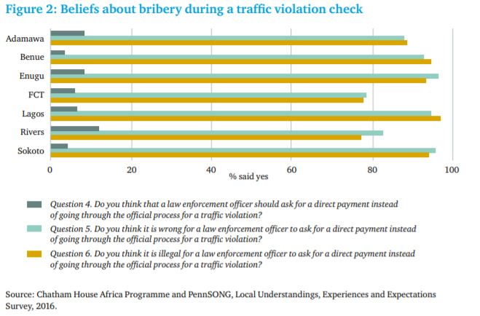
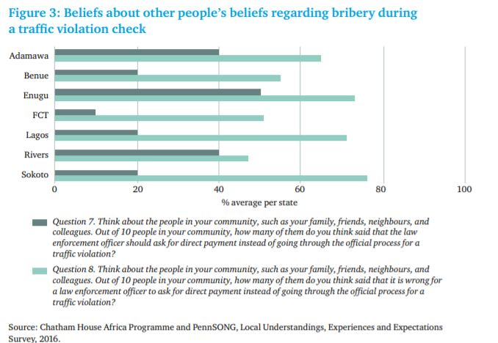
VALUE CREATION THROUGH DATA – RECENT EXAMPLES
Some highlights of the report:
For every state, individuals personal beliefs were ranked much lower than what they thought others in the community would think about the issue.
Rivers & FCT have the lowest difference in personal belief and perception of others’ beliefs. Enugu has the highest gap between the two .
Notes:
Here again we have some highlights from the survey
On the left are responses when people are asked their beliefs about bribery during a traffic violation check, and on the right are the results when the same individuals are asked about what they think other people’s beliefs are during that same traffic violation check.
For every state, individuals personal believes were ranked much lower than what they thought others in the community would think or do in that same situation. This is significant for policy reform – again to change behaviours within public service reforms, it is critical to change the perceptions around that behaviour not just for an individual but for society in general.

Slide 10
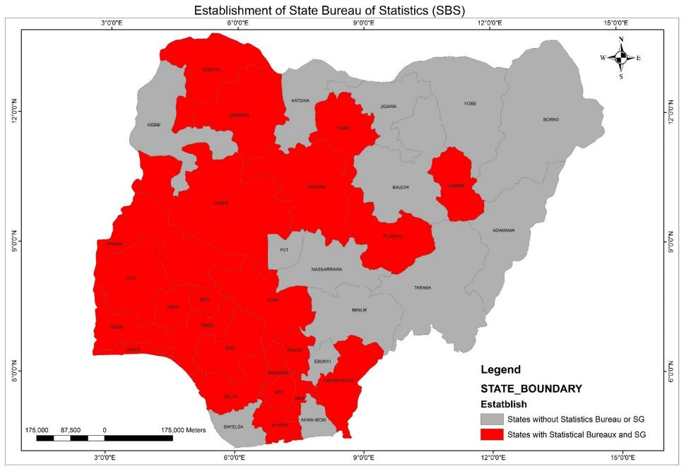
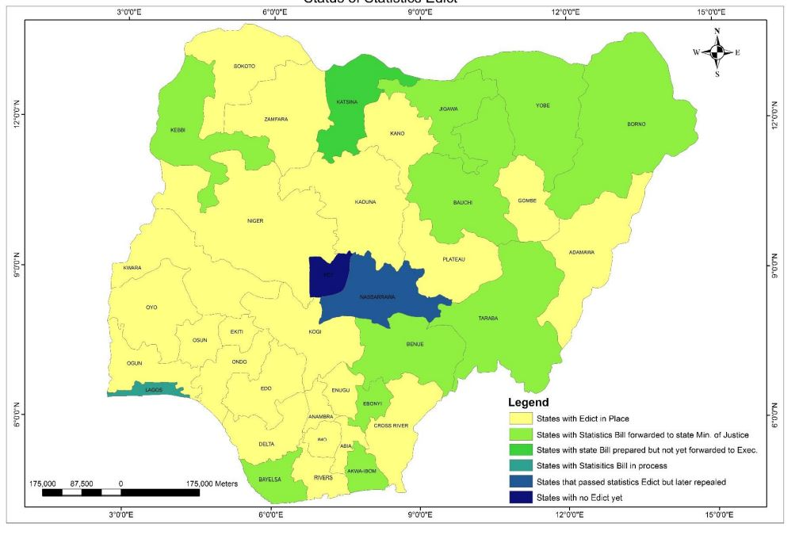
IMPROVING NIGERIA’S STATISTICAL SYSTEM
States that have established a Statistics Bureau or SG
States that have enacted Statistics Edicts
Through NBS’ role as Custodian of the National Statistical System, have taken a key role in supporting states in building a data and statistics infrastructure that can provide routine data to inform the work of agencies such as the BPSR.
Most states have established a Statistics Bureau or enacted statistical edits – which simplify the work across government in not just enacting reforms, but ensuring that they are sustainable, and outcomes are measurable.
Notes:
Through NBS’ role as Custodian of the National Statistical System, have taken a key role in supporting states in building a data and statistics infrastructure that can provide routine data to inform the work of agencies such as the BPSR.
Most states have established a Statistics Bureau or enacted statistical edits – which simplify the work across government in not just enacting reforms, but ensuring that they are sustainable, and outcomes are measurable.
The National Statistical System can be a strong resource for any agency looking to improve their ability to collect and use data for evidence-based programme planning. The availability of this infrastructure, strengthens the value that can be created from the statistical system as a whole. So we advocate that you utilize these resources in developing an internal framework for data collection and analysis.

Slide 11
CONTEXTUAL CHALLENGES TO ADOPTION OF DATA & STATISTICS
NBS collects data primarily in two ways:
Administrative – routine data generated by MDAs during the course of their work;
Surveys and Census – carried out directly by the NBS, many times in partnership with local and international agencies, or when requested in partnership with MDAs.
Still some infrastructural challenges:
Reluctance to data sharing internally, within government
Misconception that sharing data means loss of ownership or lack of visibility as relates to shared information.
Significant capacity and skills gap within government which ensures reliable data.
Notes:
Before we dive into some of the contextual challenges, we have experienced in encouraging the adoption of data and statistics across ministries, departments, and agencies, it might be useful to briefly describe the system by which NBS routinely collects and disseminates data. As the apex body of official statistics, a key function of the NBS is to centralize and mainstream the data generated within the public sector itself.
NBS collects data primarily in two ways:
Administrative – routine data generated by MDAs during the course of their work - (such as how many births are attended to by a healthcare worker, or how many beds are available across local government areas)
Surveys and Census – carried out directly by the NBS, many times in partnership with local and international agencies, or when requested in partnership with MDAs
Now in carrying out our mandate, NBS still faces some infrastructural challenges. For instance – we still need to address the resistance to data sharing internally, which is reinforced by the realization that with transparency comes accountability, or the common misconception that sharing data means the loss of ownership or visibility as it relates to the information being shared.
These challenges exemplify our resolve at the NBS that efficient public service reform should come from engaging with data not only from an implementation point of view but from the point of view of understanding the operational and practical implications of what the data says. And as NBS has worked diligently over the last few years to ensure timely and reliable information, we have equally pushed for its use as a core tool for improving the productivity and performance of public service delivery.
We also need to address the capacity and skills gap within government which is required to ensure timely and reliable transmission of administrative data

Slide 12
SUPPORTING DATA & STATISTICS INTEGRATION INTO PUBLIC SERVICE REFORM
Policy:
Anchored by reform objectives with the National Development Plan and the Economic Sustainability Plan
Requires cooperation, collaboration, and coordination
Bureau of Public Service Reform, Office of the Secretary General of the Federation
National Statistical System – anchored by the NBS
Other relevant MDAs
Infrastructure & Culture:
Regulatory frameworks and enabling policies
Private sector support where relevant
Ecosystem of stakeholders for public service reform can aid innovation in reforms & communication on reforms – e.g. Nigerian Economic Summit Group, etc.
Some subnational governments are active and exemplary in addressing public service – drive an environment of collaboration & learning
Notes:
Before I conclude, I would like to highlight the building blocks to supporting data and statistics integration into public service reform.
First, there’s the policy framework and infrastructure:
- this is usually rooted and anchored by the reform objectives of the National Development Plan and the Economic Sustainability Plan. The guidelines provided within these national frameworks provide marching orders for all interactions with the objective of service reform.
The policy framework being wide in scope requires cooperation, collaboration, and coordination to be able to meet data and statistics goals. Often data is required from other agencies to enable BPSR to effectively perform its role. Policy frameworks provide a backing for these types of interaction but collaboration, cooperation, and coordination can achieve targets and objectives much more quickly.
Secondly, and perhaps just as important is the data infrastructure & culture that is required in order to have robust data-driven decision making systems. Internally, it is important to have regulatory frameworks and enabling policies which encourage data awareness, data usage, and data sharing. It can also be useful to incorporate resources from the private sector to support the development of an enabling culture for data use, particularly in training and capacity building opportunities. Some subnational governments are also active and exemplary in addressing public service reforms – collaboration will drive a mutually beneficial environment of results and learning.

Slide 13
SUPPORTING DATA & STATISTICS INTEGRATION INTO PUBLIC SERVICE REFORM
Building Trust:
Internally & externally
Often-downplayed but critical to the mission of public service reforms
Before data can be deployed in any meaningful way, both external and internal users must trust the data and ensure that the data is being used in ways that reinforce public trust.
Transparency & openness are key pillars of building trust
NBS role:
As custodian of official data and coordinator of the National System, NBS is aware of the critical role we can play in building trust and is committed to this role
Strongly supports collaboration and cooperation, and is happy to work with MDAs in improving the quality of data about Nigeria’s society and economy
Notes:
An often-downplayed aspect of data which is critical to its positive use in policy outcomes is the issue of trust. Before data can be leveraged towards meaningful use, both internal and external users must trust the data and ensure that the data is used in ways that reinforce public trust. As the national statistics office, custodian of official data and coordinator of the National Statistical System, NBS is aware of the critical role it can play in building trust and improving the efficiency of government interventions. It is our custom to strongly support collaboration and cooperation, and NBS is happy to work with MDAs in improving the quality of data about Nigeria’s society & economy.
We believe that these efforts ultimately contribute to coordinating governance initiatives including public service reform, while enshrining evidence-based decisions as a long-term vision.

Slide 14
CONCLUSIONS
Data is critical for public service reforms. Improved data use and data sharing is central to achieving our collective goals for successful reform outcomes.
The demand for evidence backed programs and measured outcomes is growing and is not likely to abate anytime soon. Big data and new technological advancements mean there are increasing pressure for robust reform processes and users want data and statistics on results and outcomes.
At the same time, incorporating data and statistics into the reform process requires deliberate investments in cultivating a data culture internally, and ensuring that the technical and capacity building is provided in order to meet the challenges.
Data and statistics in the public service area relies on collaboration, coordination, and cooperation. Once trust is built internally, external partners such as MDAs also need to be able to trust. This solidifies better use of data across board, improves accessibility of data, and drives evidence-backed decision making for success.
Notes:
In conclusion, I’d like to iterate that:
Data is critical for public service reforms. Improved data use and data sharing is central to achieving our collective goals for successful reform outcomes.
The demand for evidence backed programs and measured outcomes is growing and is not likely to abate anytime soon. Big data and new technological advancements mean there are increasing pressure for robust reform processes and users want data and statistics on results and outcomes.
At the same time, incorporating data and statistics into the reform process requires deliberate investments in cultivating a data culture internally, and ensuring that the technical and capacity building is provided in order to meet the challenges.
Data and statistics in the public service area relies on collaboration, coordination, and cooperation. Once trust is built internally, external partners such as MDAs also need to be able to trust. This solidifies better use of data across board, improves accessibility of data, and drives evidence-backed decision making for success.

Slide 15
Plot 762, Independence Avenue,
Central Business District,
Abuja.
Email: ykale@nigerianstat.gov.ng
Web: www.nigerianstat.gov.ng
www.facebook.com/nigerianstatistics
@nigerianstat
THANK YOU FOR YOUR ATTENTION!
Notes:
Thank you for listening and we welcome any feedback on the contents as presented or suggestions for improvement or collaboration.

Slide 16
For the presentation, visit:
www.bpsr.gov.ng
www.nigerianstat.gov.ng

