Slide 1


The Federal Government of Nigeria and the
Open Government Partnership
July 2016

Slide 2



What is the Open Government Partnership (OGP)?
A multi-stakeholder initiative through which governments make concrete commitments to open government.

Slide 3
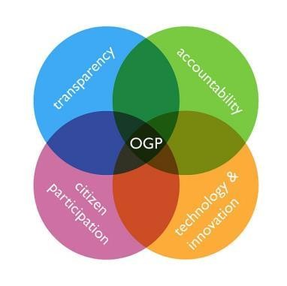
What is “open government?”
A government where people:
Have access to information about the decisions that interest them.
Can participate in decision- making at all levels.
Can hold officials accountable
for decisions and actions.
Use technology to promote
the above values.

Slide 4
How OGP works

Join
If eligible, country joins

Co-create
commitments
Government & civil society co- create national action plan

Implement
Government implements commitments

Learn
Contribute to peer learning
Assess
Publish self-assessment & participate in Independent Reporting Mechanism

Slide 5
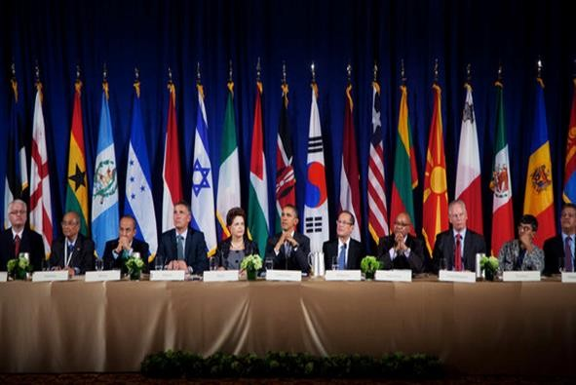
















Brief History of OGP
2011: OGP launched by 8 founding countries: Brazil, Indonesia, Mexico, Norway, the Philippines, South Africa, the United Kingdom and the United States.
2012-2015: OGP expands rapidly to include 69 participating countries and thousands of civil society organizations.
2015: 50 OGP countries commit to using OGP national action plans as one means to implement the 2030 Sustainable Development Goals (SDGs)

Slide 6
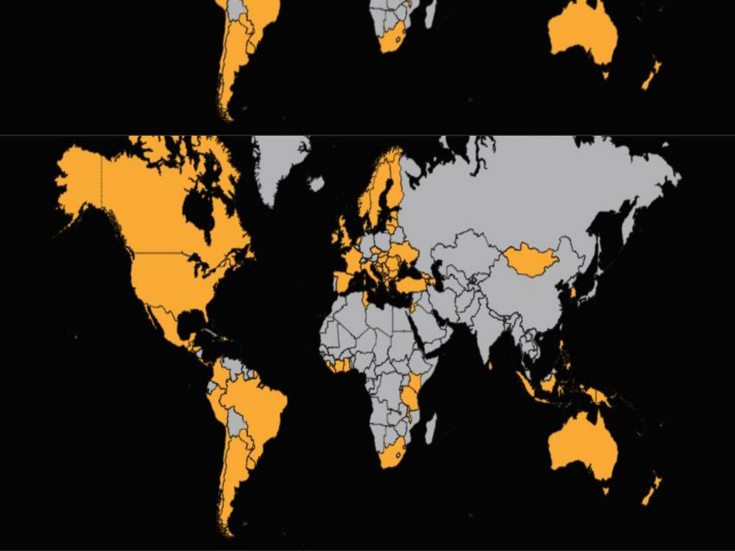

1000s
of Civil Society Organizations
70
Participating Governments
110
National Action Plans
+2500
Reform commitments

Slide 7
Why has OGP grown so rapidly?
Address national priorities
Access global platform
Benefit from independent evaluation Engage with new actors

Slide 8

Examples of OGP Commitments

Slide 9
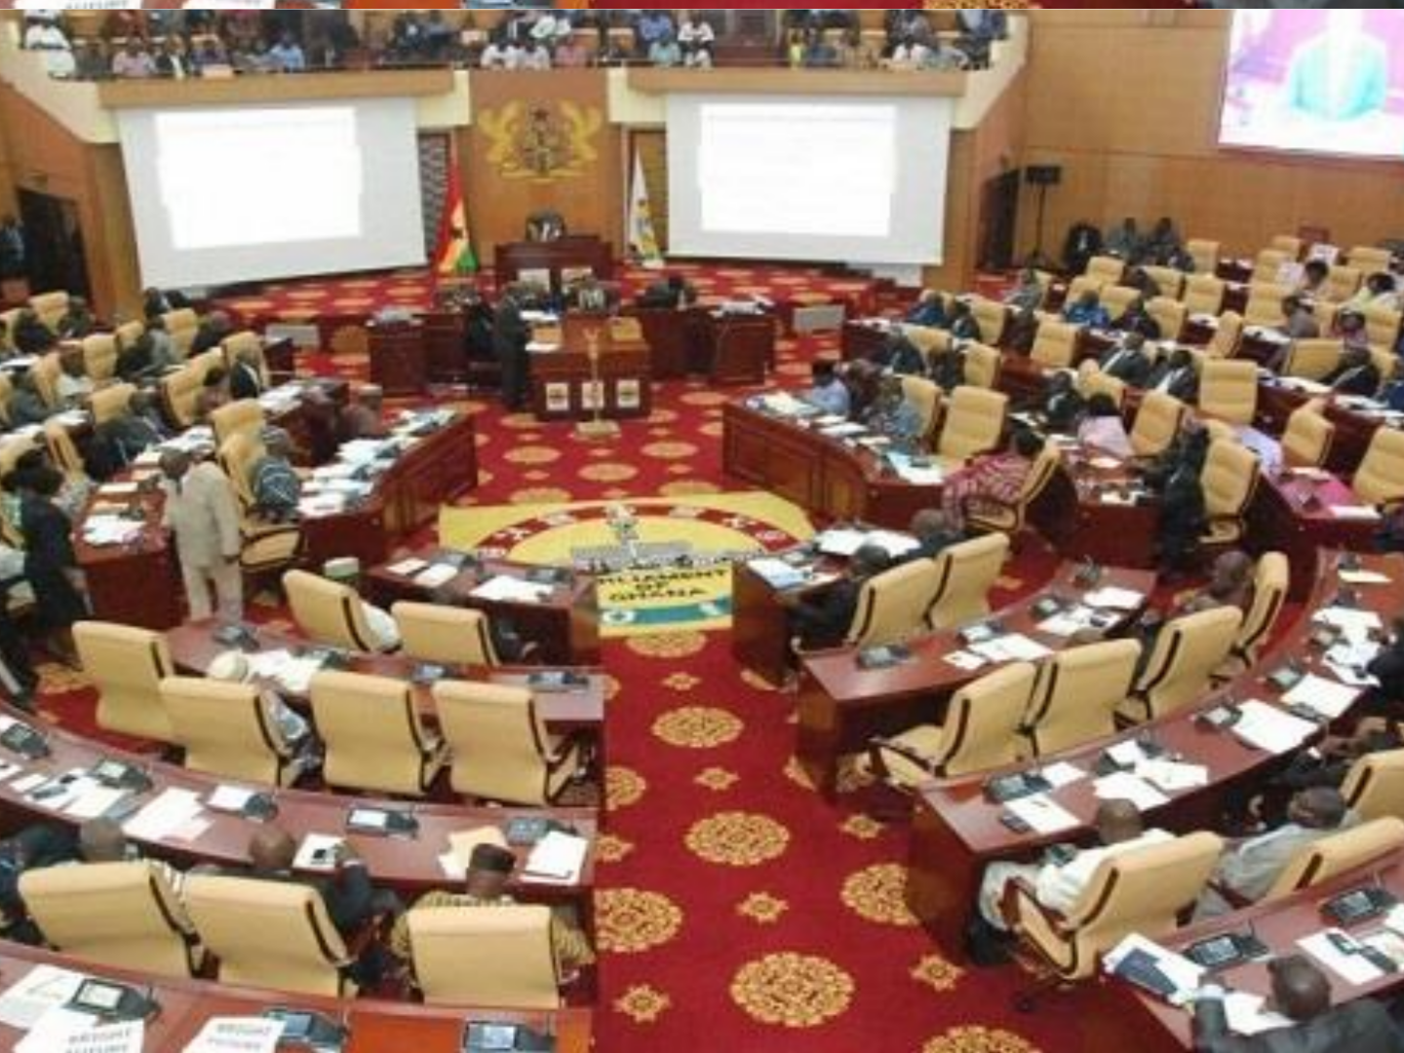




Ghana: Publish more budget
information online.

Slide 10

Mongolia: Release environmental information in open formats.

Slide 11

Ukraine: Publish the
Soviet era files.

Slide 12
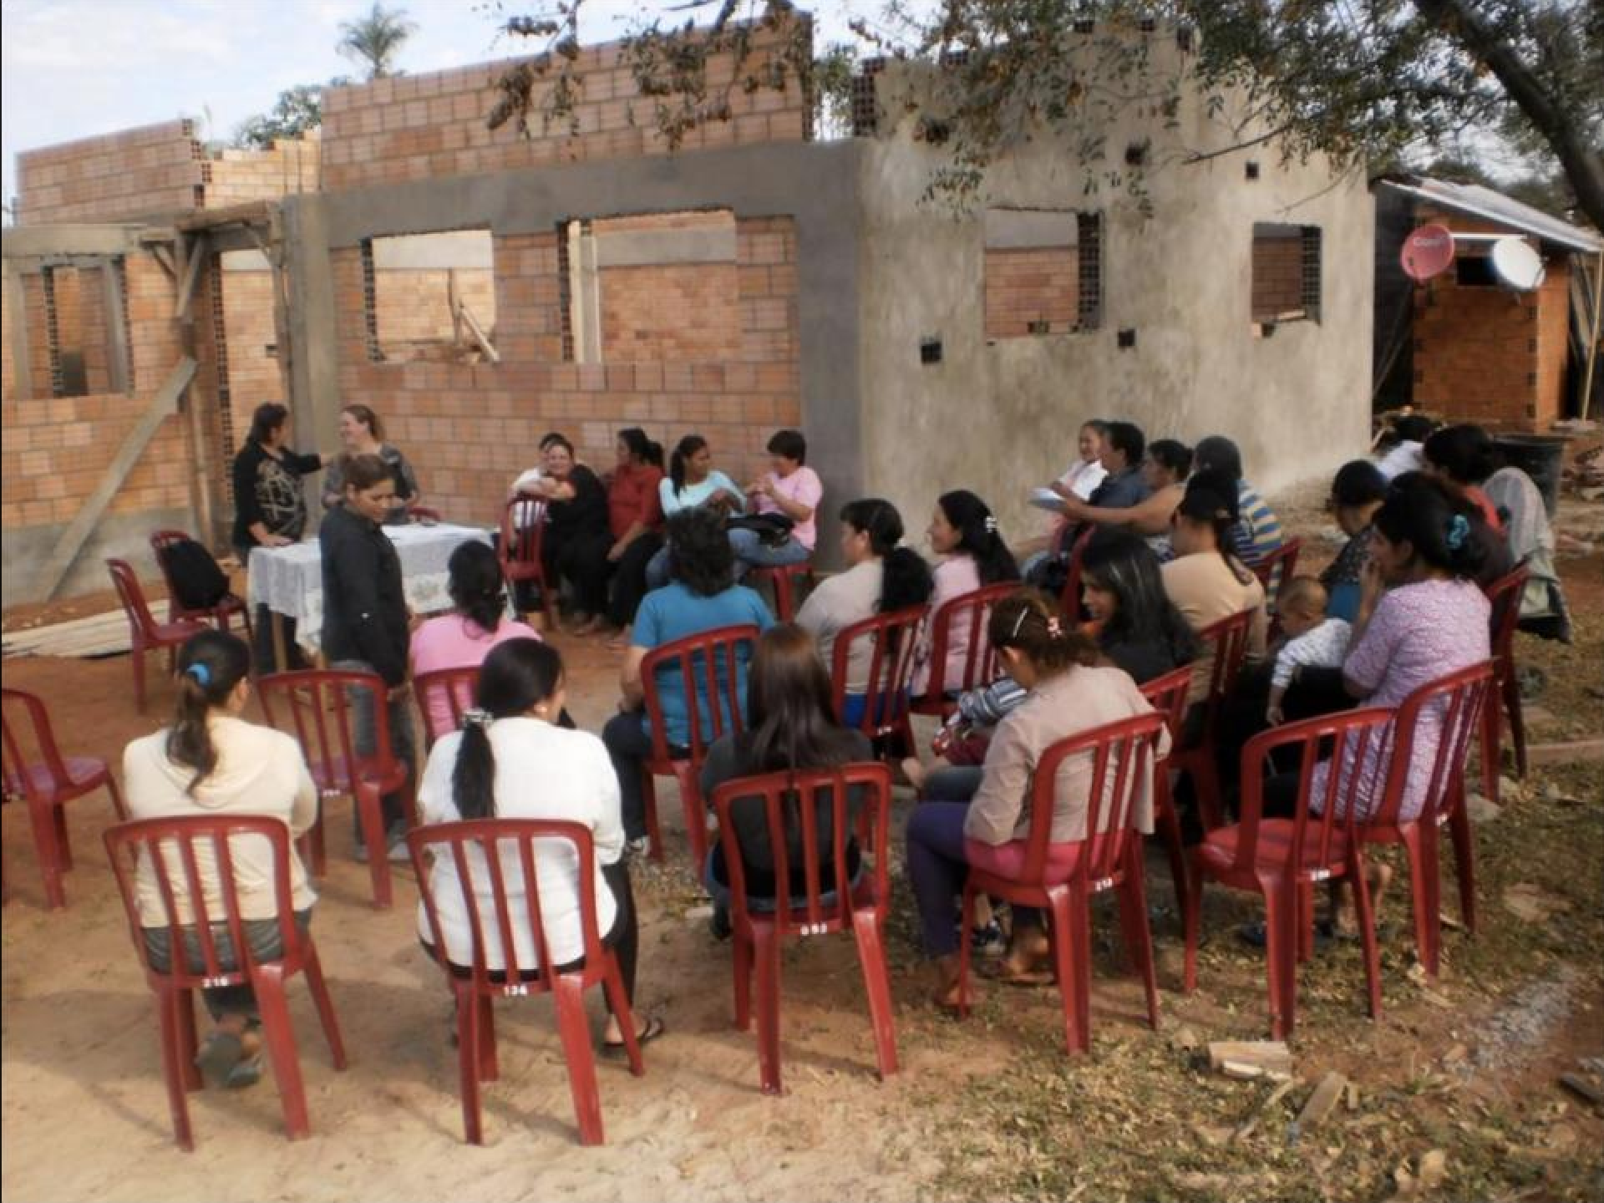





Paraguay: Strengthen local
dialogue councils.

Slide 13
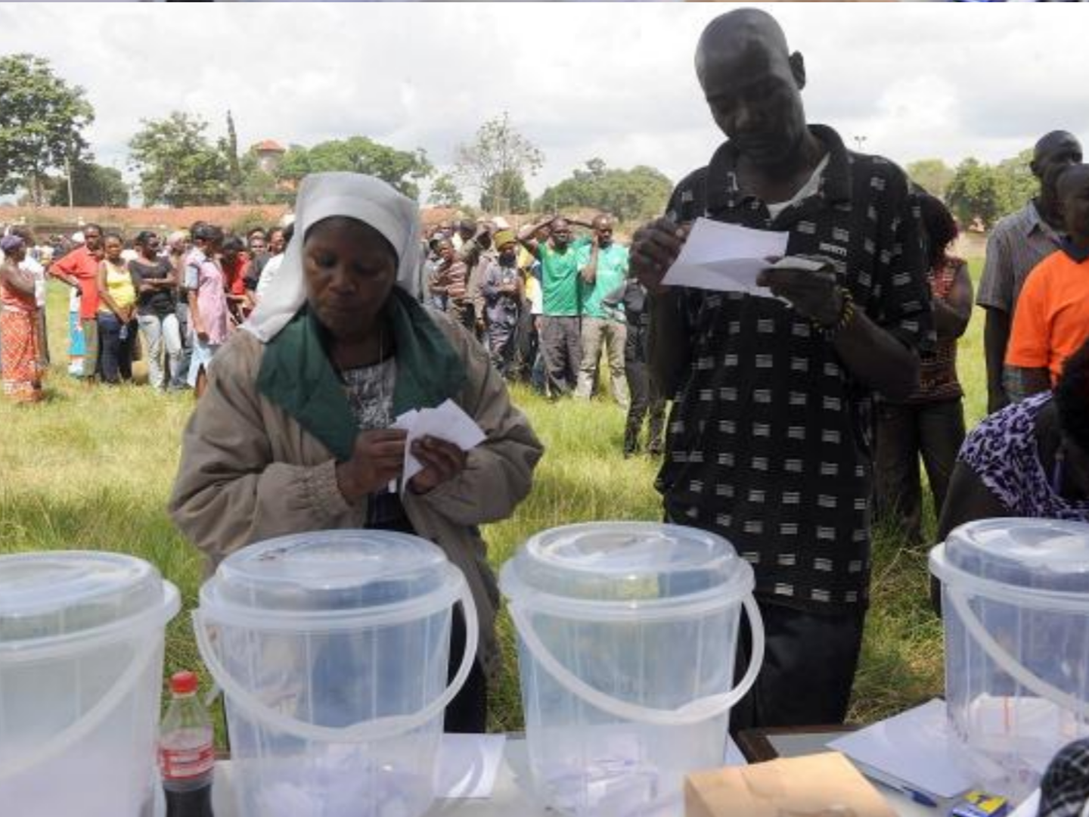








Kenya: Improve transparency
in electoral processes.

Slide 14

Nigeria Has Already Made a Lot of Progress
Freedom of Information Act 2011
Fiscal Responsibility Act 2007
Public Procurement Act 2007
Federal Budgets Online
Increasingly Credible and Transparent Elections
Commitment to EITI
Vibrant Civil Society Demanding Openness

Slide 15
How can countries join?
Demonstrate eligibility
Fiscal Transparency, Access to Information, Asset disclosure, and Citizen engagement

Submit letter of intent
 Identify lead ministry to
co-create action plan

Slide 16
Nigeria’s OGP Membership Journey
Eligible to join OGP
Meets minimum criteria on:
  Fiscal Transparency
  Access to Information
  Asset disclosure
  Citizen engagement
Has Submitted Letter of Intent
Has Identified Federal Ministry of Justice as Lead Ministry

Slide 17
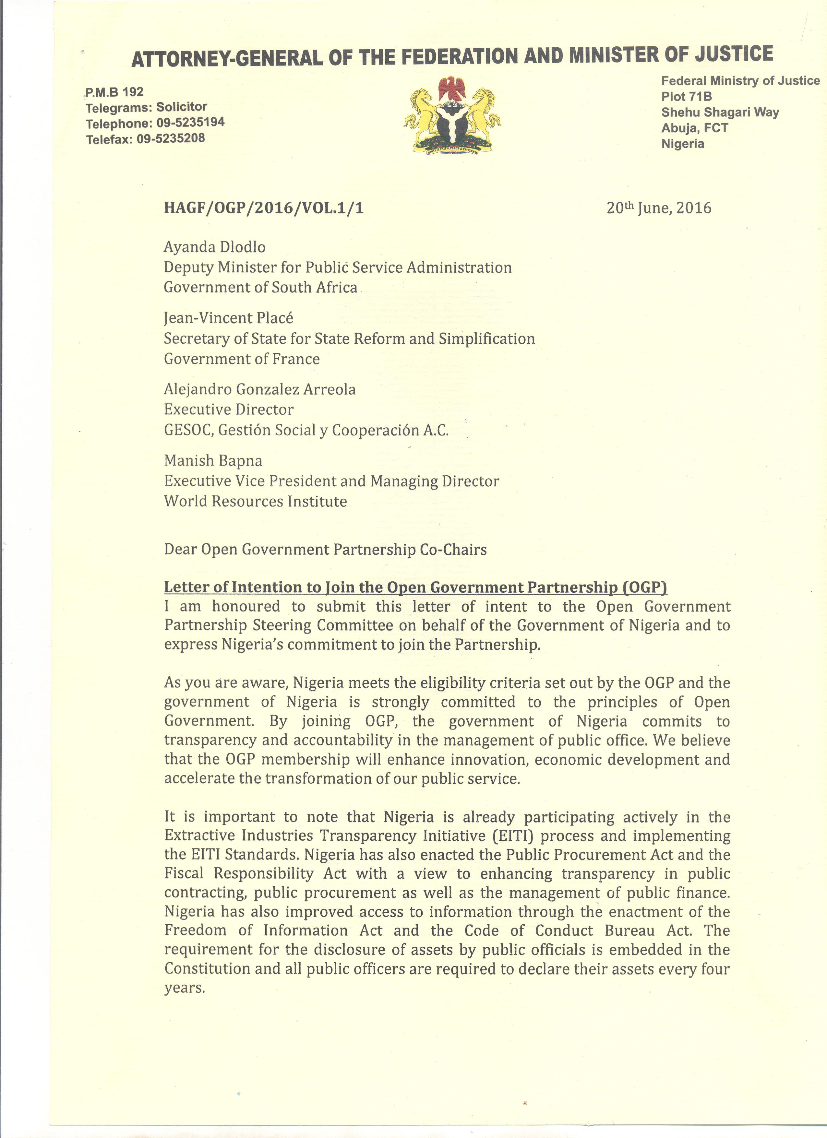
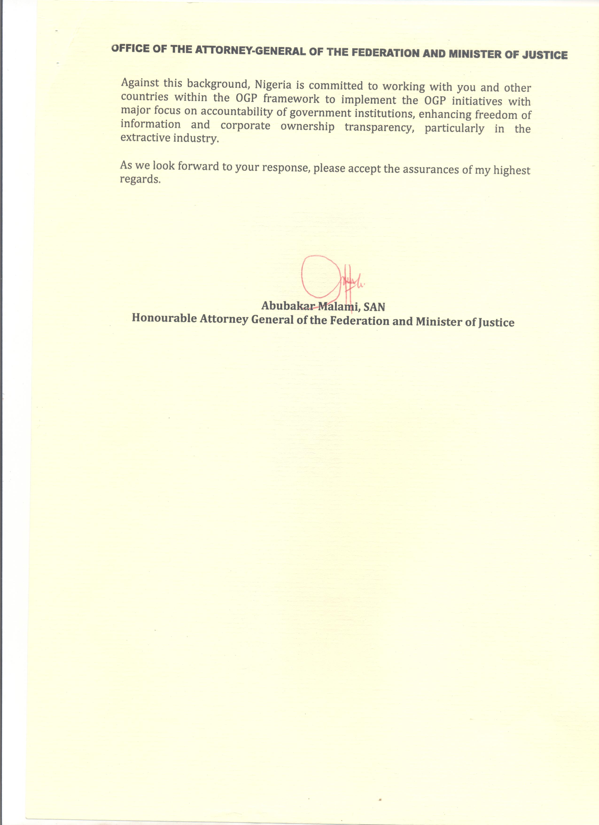

Slide 18
“Co-Creation” / Consultation Process
Public/ civil society must be involved in developing
and implementing National Action Plan
Flexibility allows each country to design their own process
But must follow basic guidelines to ensure meaningful consultation

Slide 19
“Co-Creation” / Consultation Process
Keys to success:
  Adequate notice and awareness-raising among public
  Breadth of consultation – wide array of
stakeholders
  Allowing civil society groups to self-select to participate (rather than hand-picking them)
  Responding to inputs and feedback through iterative consultation process
Good practice: Permanent multi-stakeholder
dialogues (used in 36 OGP countries)

Slide 20

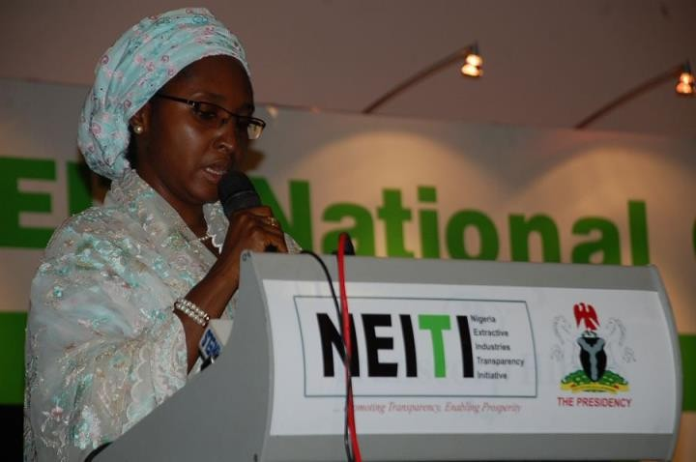
Nigerian experience with multi-stakeholder dialogue
Member since 2004
Governed by representatives of government, extractive companies and civil society

Slide 21
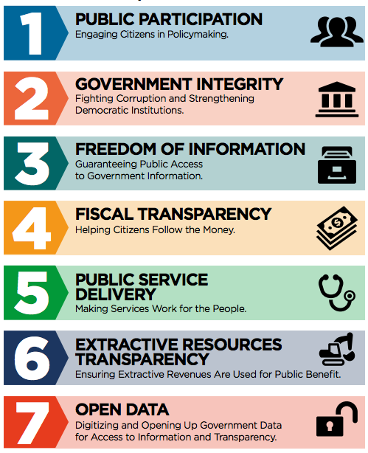
COMMON
COMMITMENT
THEMES

Slide 22
 Ambitious
A good action plan is…
Do commitments stretch government beyond
current state of practice?


Responsive
Is the plan reflective of public demand?
Relevant
Does the plan address key open government principles of Transparency, Accountability, and/or Public Participation?

Slide 23

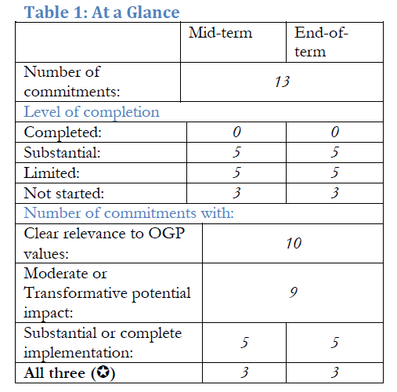
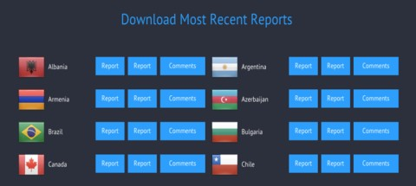
Assessment
Self-Assessment Reports
Independent Reporting Mechanism (IRM) Reports

Slide 24
RESOURCES AVAILABLE TO OGP PARTICIPATING COUNTRIES

Slide 25



WORKING GROUPS
Anti-Corruption (new!)
Access to
Information
Fiscal Openness
Open Data
Legislative
Openness
Openness in
Natural Resources

Slide 26


PEER LEARNING
IRM Reports
OpenGov Guide

Slide 27
AVOIDING PITFALLS
✓ Ensure interagency coordination
✓ Provide high-level political support
✓Develop implementation plan for commitments (i.e., budget allocations, agency leads, timeline, etc.)
✓ Establish permanent government-civil society dialogue mechanisms

Slide 28
Questions/ Discussion

