Slide 1
The Federal Government of Nigeria Information App (FGNIApp)
Presented by
Permanent Secretary Federal Ministry of Information & Culture
Mrs. Ayotunde Adesugba

Slide 2
Introduction
In the world today, the use of Social Media in providing information and disseminating news to the populace is fast growing.
Social Media is now a commonly used platform in interacting with people. This also cuts across all age grades.
The need for the Ministry of Information and Culture to key into this trend cannot be over emphasized because part of its statutory responsibility is to bridge the information gap between the government and her citizens at home and in the Diaspora.
The Government also requires a platform where government's policies and activities are brought to the attention of the people in real time and at a minimal cost.

Slide 3
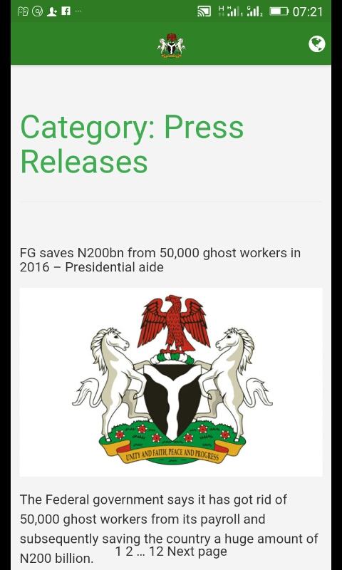
The FGN IAPP
The FGN IAPP came about as a fulfillment of the Ministry's desire to leverage on the unique power of Information and culture to drive the Change Agenda policy of the government with a view to ensuring that Nigerians take ownership of the Change Agenda to bring about a paradigm shift in the way we do things.

Slide 4
The idea of the FGN IAPP
The idea of the FGN IAPP was also borne out of the passion of the Ministry to live up to its mandate as the information disseminating organ of the Federal Government of Nigeria and act responsibly in discharging its duties.

Slide 5
The idea of the FGN IAPP Contd.
Applications and Websites are accessed on hand-held device such as Smart Phones (e.g Iphones, Android, Blackberry, Tablets etc), but that is where the similarity ends.
APPS are very popular for obvious reasons over websites: They are personalized; offering specific or tailored communication based on interests, needs or usage.
It is usually self contained. You can even be notified that a message has just dropped on your phone instead of sending emails.

Slide 6
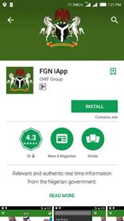
The idea of the FGN IAPP Contd.
Apps or applications are downloaded and installed on your device rather than accessed through browsers which is what is obtainable in the case of Websites.
This makes retrieval faster due to the fact that Apps store their data base locally on the mobile devices instead of an external server.

Slide 7
The idea of the FGN IAPP Contd.
Specifically, the FGN IAPP which we are considering today simply put is to bring Governance closer to the people.
It attempts to connect with the people on the go.

Slide 8
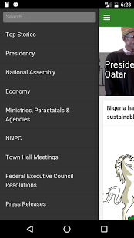
The FGN IAPP Menus
The IApp contains various menus where users can interact and even get to meet the government if they so wish, for example, "The get inspired" column allows users to subscribe and meet a notable figure in Nigeria who can really serve as a source of inspiration to youths.
The feedback menu is also designed to allow users give their opinion on certain government policies or activities of interest.

Slide 9
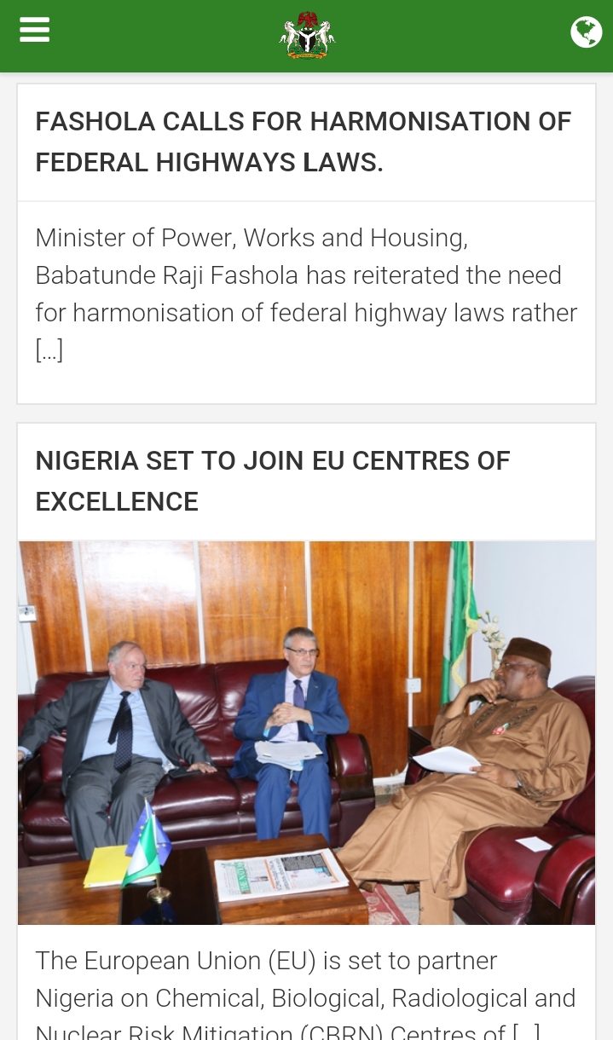
The FGN IAPP Menus Contd.
Some of these feedbacks are also sent directly to the Ministry's webmail where suggestions and criticisms are treated accordingly or processed for further necessary action.
Apps are immediately and instantly available because they are already on your phones.

Slide 10
Official Launch of the FGN IApp
IAPP is a new way of doing what we have been doing before. Issuing everyday bulletin and releases. This only makes it faster, convenient and stress free.
Welcome to the Federal Ministry of Information and Culture super Information high way.

Slide 11
How to search and download the FGN IApps on Google Play for Android Users
• Tap the Google Play icon on your home screen. • Tap the white search bar at the top of the screen • Enter the name of the app (FGN IApp). • Tap the search icon on your keyboard (should be in the location of the Enter key). • Tap on (FGN IApp) in the search results or categories. • Read through the app's description and reviews to ensure the app seems right for you. • Tap Install.

Slide 12
How to search and download the FGN IApp in the App Store for Apple Users (IPhone & IPad)
• Open the App Store app. • Tap the Search icon at the bottom of the screen. • Enter the app name (FGN IApp) that you are looking for. • Tap Search on your keyboard. • Tap the FGN IApp you wish to download is free. • Tap Get it, is free. • Tap Install when the icon switches. • Enter your Password or use Touch ID when prompted. • Wait for the download to finish. • Press the Home button to go back to your device's Home screen.

