Slide 1
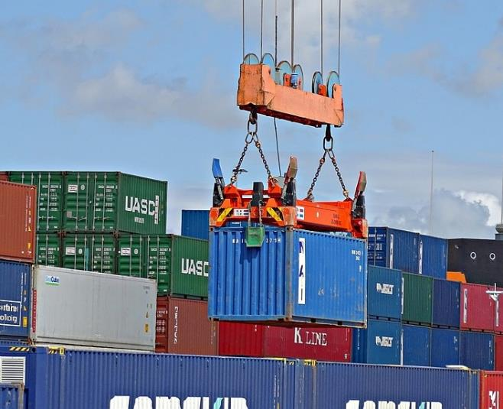
Building an Enabling Business Environment
OVERVIEW OF THE EASE
OF DOING BUSINESS INITIATIVE
Dr Jumoke Oduwole
SSA to the President on Industry, trade and Investment (OVP)
May 2017

Slide 2
Building an Enabling Business Environment
ADDRESSING THE REMOVAL OF OF THE EASE
OF DOING BUSINESS INITIATIVE
Dr Jumoke Oduwole
SSA to the President on Industry, trade and Investment (OVP)
July 2017

Slide 3
7_89
Outline
Current assessment of the Enabling Environment
The vision and plan for improving the Enabling Environment
Ongoing Reform Efforts and Next Steps
Overview of EoDB Executive Order
Conclusion

Slide 4
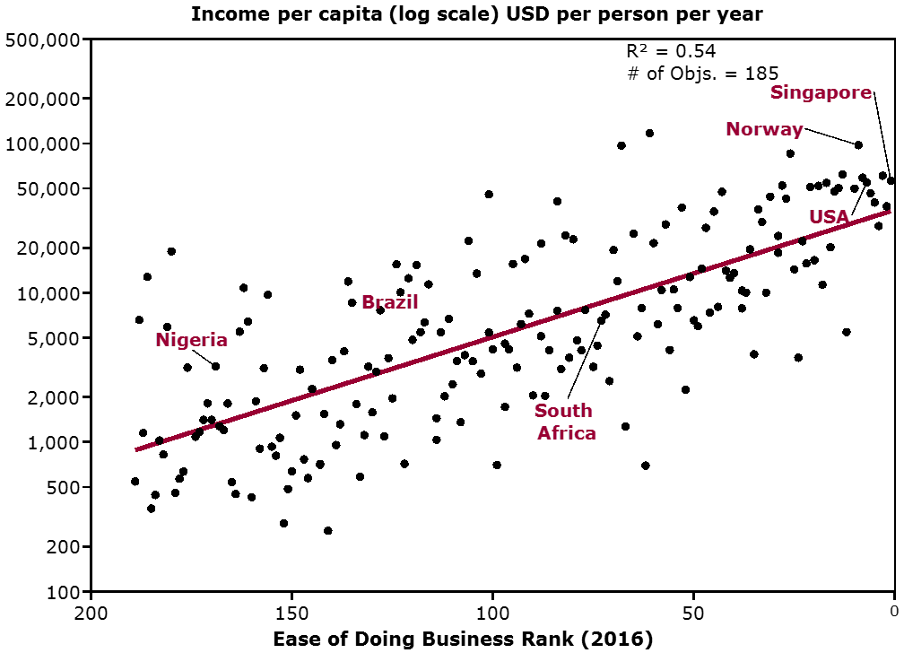
There is a strong correlation between a country’s “Ease of Doing Business” and its economic prosperity
THE CASE FOR REFORM
SOURCE: World Bank – ‘Doing Business’ report; Lit. Search

Slide 5
Why? Attractive business and investment environment is critical for prosperity
“A good investment climate fosters productive private investment—the engine for growth and poverty reduction. It creates opportunities and jobs for people.”
“Improving the investment climate— the opportunities and incentives for firms to invest productively, create jobs, and expand—is the key to sustainable progress”
-World Bank

Slide 6
Nigeria aspires to be one of the most attractive investment destinations
FINANCIAL TIMES
MONDAY, 4 FEBRUARY 2019
Nigerian GDP rises to ~USD 750 billion
Nigeria reaches yet another economic milestone with less than 20% of the population under poverty line
Nigeria: A textbook African success story
Nigeria has come a long way over the last three years, coming back from the brink of near economic disaster to become a textbook example of how an African country can turn itself around.
When oil prices crashed to $30 a barrel in 2015, the country took an economic nose dive. Its heavy reliance on oil exports saw the Naira devalue in the parallel market to over ₦400/USD.
The Buhari Administration had to act and act fast. It took the radical step of launching the Nigerian Industrial Revolution Plan to reinvigorate the non-oil sectors, create jobs and develop a growing SME segment.
“What they have done is nothing short of a miracle,” says IMF chief.
How did they succeed where others have failed?
The Government pledged its unwavering commitment to reforms aimed at creating a business-friendly environment. Today, the results are there for all to see.
Visas are processed at the borders within 30 minutes of arrival; new preclearance processes enabled by technology push goods through the ports at lightning speed; the number of tax payments a year has been slashed from 59 to 12; and the number of days required to start a business and get electricity has dropped to 15 days and 100 days respectively from 30 days and 181 days.
Nigeria is now the location of choice for investors into Africa, with the knock-on effect of creating 1,000,000 direct new jobs since 2016. Today it ranks 100 out of 189 countries for ease of doing business - a far cry from its ranking of 169 in 2016.
Ease of doing business rankings
200
100
0
2007
2016
2019

Slide 7
Nigeria is considered a difficult place to do business
Benchmarking metrics
Ranking out of 189 (2016)
Overall: Ease of doing business
Key insights
Sub-components of Ease of Doing Business:
Starting a business
Nigeria moved up one place from in the Ease of Doing Business in 2016 but still ranks 36 out of 47 in sub-Saharan Africa
Drastic, fast-paced busi-ness reforms must be conducted simultaneously to improve the business environment and attract foreign investors
Reforms must be adopted within the next 12 months to reflect in the 2018 Ease of Doing Business report (out October 2017)
Getting electricity
Getting credit
Enforcing contracts
Nigeria
Ghana
South Africa
Kenya
Angola
Rwanda
Georgia
SOURCE: World Bank ease of doing business index

Slide 8
Nigeria relative to best-in-class across indicators
THE CASE FOR REFORM
FRONTIER
Nigeria scored 44.63 points in Distance to Frontier in the World Bank’s Doing Business 2017, giving it a ranking of 169th overall, out of 190 countries

Slide 9
Our historical attempts at improving ‘Ease of Doing Business’ rankings have been largely unsuccessful
Launched initiatives to improve investment climate…
…however, failed to enhance business environment in nigeria
Programs and partnerships
Launched Sub-National Investment Climate Program in 2006
Partnered with Department for International Development and World Bank
Starting business in Nigeria getting more difficult – World Bank
, 2015
Established council
Established National Competitiveness Council of Nigeria in 2013
Aimed to improve Nigeria’s global competitiveness ranking and revitalize the economy
“Reforms instituted by Nigerian leaders had not impacted the Ease of Doing Business… a lot more needs to be done to make the country investment-friendly.”
New Telegraph, 2014
Industrial revolution: Jonathan inaugurates National Competitiveness Council
Federal Ministry Of Information And Culture, 2013
Source: Lit. Search

Slide 10
….mainly due to internal governance roadblocks, despite having prioritized initiatives
Perceived widespread corruption and bureaucracy | Lack of coordination | Lack of motivation to confront realities
Nigeria ranks 136th in Transparency International's corruption index among 174 countries Government bureaucracy and lack of transparency in administration reducing investor confidence | Lack of coordination between ministries and agencies, inadequate planning and monitoring has led to poor implementation/ follow-up | Lack of political will and determination by government to pursue existing blue-prints and initiatives Limited faith by citizens in institutions of state and political leadership of Nigeria
“Lack of an effective ethical organizational framework to coordinate the activities of various institutions has astronomically worsened unethical practices… in the Nigerian public service.”
Scientific Research Publishing Journal, 2014
“There's no doubt that for many companies, corruption remains the biggest obstacle against investing in the oil-rich African nation [Nigeria].”
Deutsche Welle, 2015
“[Nigeria] policy needs to be better focused, more realistic and implementable. Many obvious policy steps and initiatives seem to be avoided.”
Financial Times Blog, 2015
Source: Lit. Search; Independent analysis

Slide 11
“While we are not unaware of the challenges currently being faced by our businesses, on our part, the Government remains relentless in our goal of removing the obstacles and roadblocks that have long afflicted commercial activity in Nigeria.” - His Excellency, the Vice President of the Federal Republic of Nigeria (2016) “Our overarching goal should be improvements and reforms that will be visible not merely in our numerical rankings, but in the stories and testimonials of business owners and entrepreneurs across the entire country. …beyond the specific indicators, we should be aiming for visible, irrefutable and sustainable change across the widest possible spectrum of the business environment.” - Honourable Minister, Federal Ministry of Industry, Trade & Investment (2016)
The Vision of this Administration

Slide 12
Nigeria aspires to become Africa’s leading economy, we have to become more business friendly
aspirational
Ease of Doing Business ranking by 2019/2020
Ease of Doing Business ranking today
Ease of Doing Business ranking in 10 years
Top 50
Top 100
#169
Nigeria has a vision to improve the poor Nigerian business environment and Ease of Doing Business ranking across key regulations, processes, support systems, execution capabilities and training amongst other metrics

Slide 13
PEBEC Reform Agenda
Project overview and structure
The Federal Government has prioritised the holistic improvement of Nigeria’s business environment for local and foreign businesses – especially SMEs – to drive economic development
July 2016 the President approved the Presidential Enabling Business Environment Council (PEBEC)
Chaired by H.E. the Vice President
Comprised of 10 Honourable Ministers, the Central Bank governor, the Head of Service, Reps of NASS, LASG, KASG and the private sector.
PEBEC is supported by the Enabling Business Environment Secretariat (EBES), a small task force responsible for driving the reform agenda and ensuring implementation across MDAs.
The reform agenda
A challenge as broad as “The Business Environment” requires prioritisation, across two lenses:
The private sector’s most pressing concerns;
The World Bank (WB) Ease of Doing Business (EODB) Rankings
Initial engagement with the private sector prioritised:
Entry and Exit of Goods
Entry and Exit of People
Transparency: availability and consistency of information, use of technology
With our consultative partners, we have prioritised 8 indicators, with the aim of moving Nigeria up at least 20 places in the EODB rankings:
Trading Across Borders
Starting a Business
Getting Credit
Dealing with Construction Permits
Paying Taxes
Registering Property
Getting Electricity
Entry & Exit of People

Slide 14
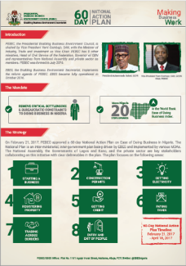
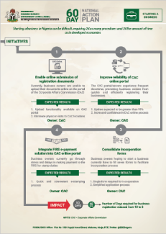
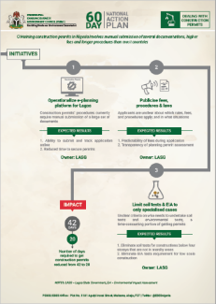
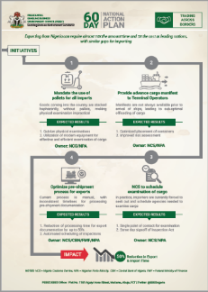
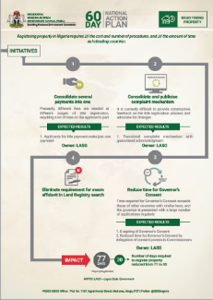
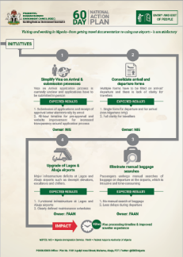
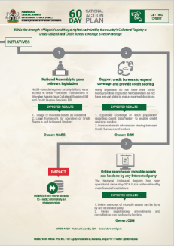
In February, PEBEC released a short term National Action Plan (NAP-60) to jumpstart our reforms and promote accountability
PEBEC’S ONGOING REFORMS
1
Prioritized initiatives/reforms
The Plan detailed, by reform Module, what initiatives have been prioritized for the next 60 days, sharing both the pain point and PEBEC’s proposed solution
2
Ownership and Impact
For each reform Module, we shared what impact Nigerians can expect if we complete our mission; we also shared who is responsible if we don’t, for full transparency
3
Firm Time Commitment
In line with the PEBEC mandate and with a view of the EODB rankings, PEBEC committed to completing all initiatives shown by April 21st, 2017
8 Indicators
22 Initiatives¹
60 Days
12 MDAs
1 Selected from a total of 56
SOURCE: PEBEC March Council Meeting

Slide 15
NAP-60 committed to a clear set of desired outcomes for each reform area and finished at 70% (pending reforms were address)
More convenient, fully online application process
Elimination of need to hire a lawyer
Number of days required to register a business reduced from 10 to 2
Passage of two bills – Collateral Registry and Credit Bureau - to strengthen legal framework
Facilitation of improved credit scoring and access for MSMEs
STARTING A BUSINESS
STARTING A BUSINESS
GETTING CREDIT
Publish laws and fees on website
Operationalize e-planning platform
Clearer application of regulations and requirements (e.g., Soil tests)
Removal of in-person requirements for TIN, with company registration
E-Filing and E-Payment processes to improve tax adherence and ease of payment
CONSTRUCTION PERMITS
PAYING TAXES
Reduction in procedures required to get connected to the grid
Reduction in time to get connected in Lagos and Kano, starting with 2 of the 11 DisCos
World standard guidelines on import procedures (e.g., palletization and advance manifests)
50% reduction in import and export times, driven by streamlined examination processes
GETTING ELECTRICITY
TRADING ACROSS BORDERS
Simplification of application process e.g. by eliminating sworn affidavit
Reduction in time to obtain Governor’s consent by 50%
48 hour visa processing timeline across missions abroad
Simplification of Visa-on-arrival
Fix infrastructural deficits at Nigerian airports
REGISTERING PROPERTY
ENTRY AND EXIT OF PEOPLE
SOURCE: PEBEC NAP-60 National Action Plan

Slide 16
The plan outlined expected impact, with plenty at stake for Nigerian SMEs; the potential value captured is truly transformational
PEBEC’S ONGOING REFORMS
PRELIMINARY - SUBJECT TO CHANGE
N 2.6bn
116,000 minutes
saved by SMEs in registration costs to start business annually
of traveler time saved daily
60%
130%
reduction in time to register property
increase in MSME access to credit
23,500 hours
20 place
saved by exporters annually
increase in Nigeria’s position in World Bank DB rankings
SOURCE: Source: Team Analysis, The Credit Crunch - CBN/IFC

Slide 17
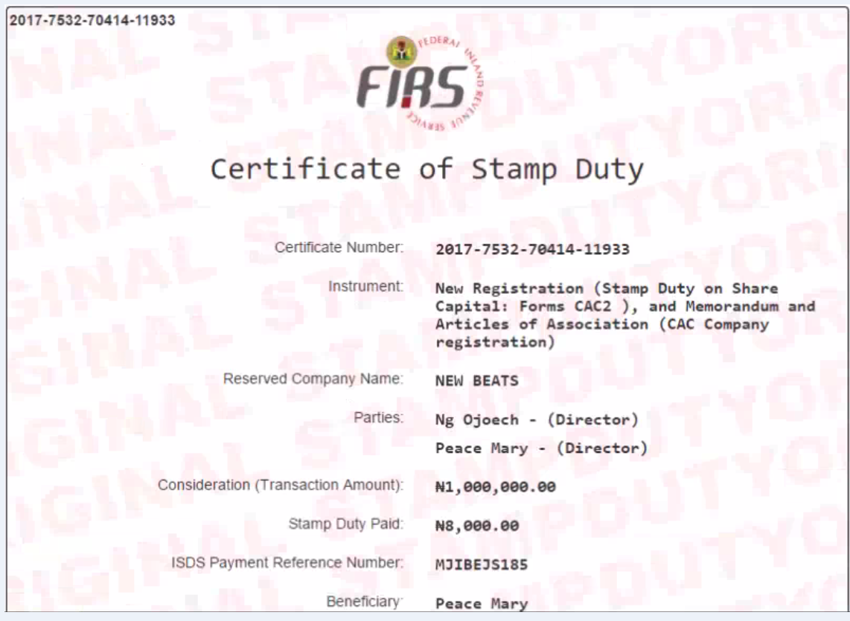
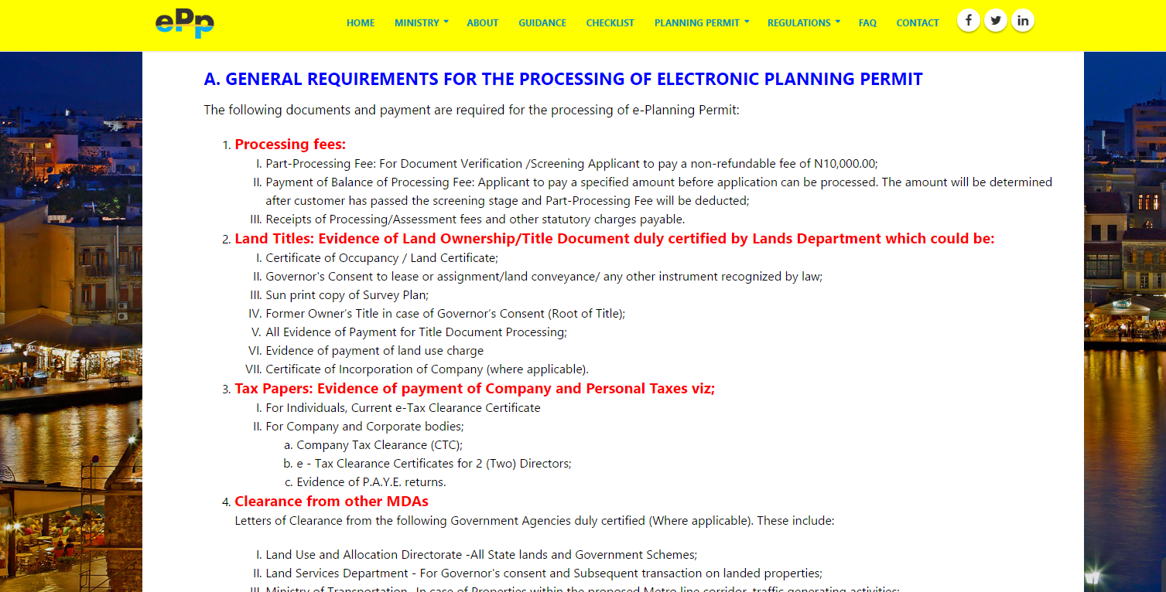
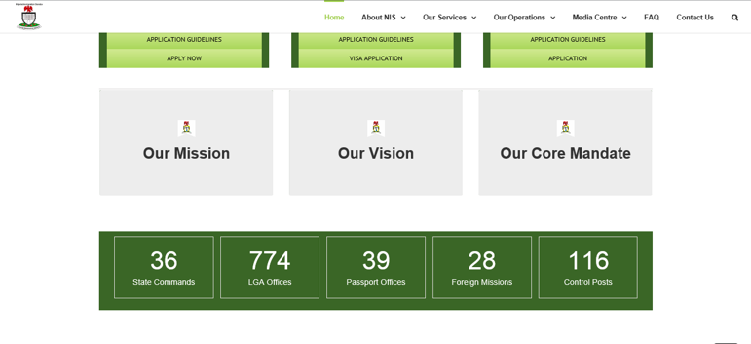
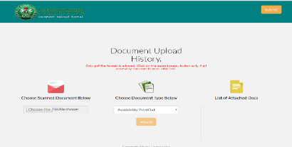
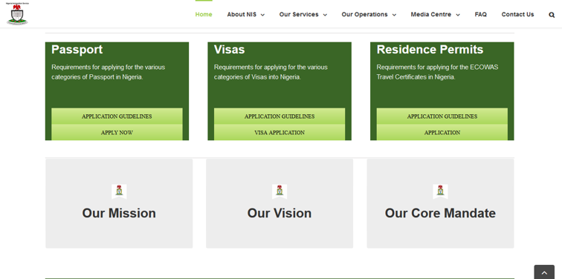
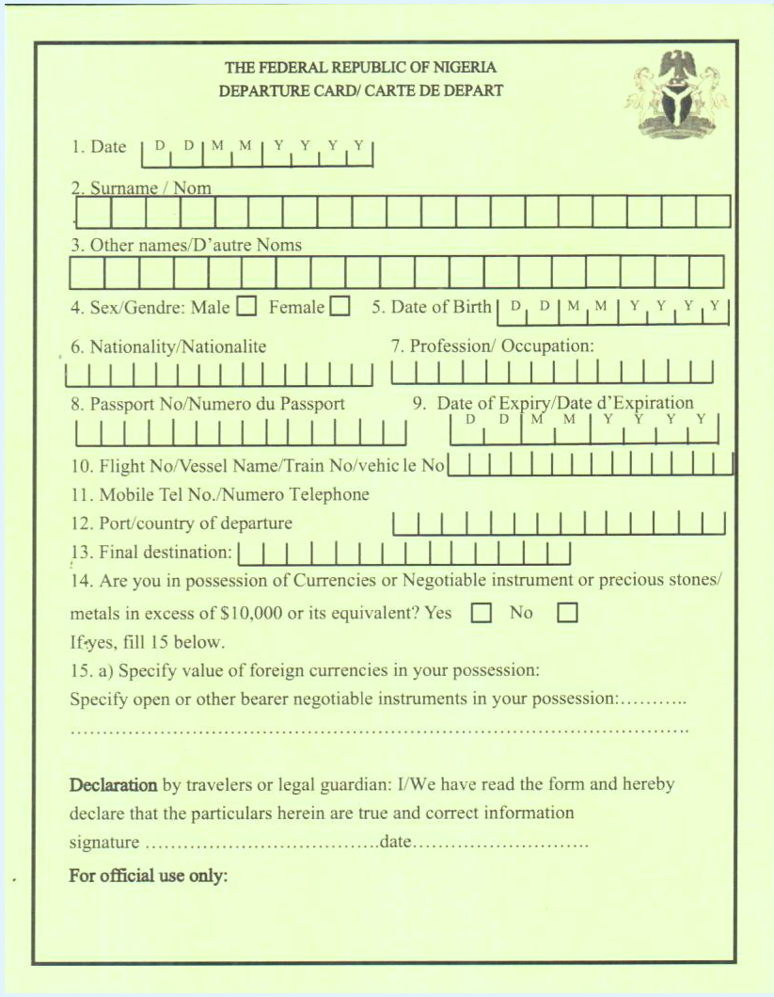
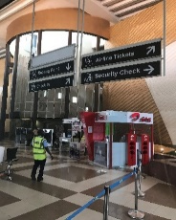
Some of the actions have driven frontline changes that Nigerians can see and feel
CAC has moved entire business registration process online, reducing time required from 10 to 2 days
LASG has operationalized its e-planning platform, allowing submission of construction permit applications online
NIS has enhanced its online functionality including e-submission of Visa-on-Arrival applications
Other
agencies
Agent
Customs officer
FAAN has implemented extensive reforms in Abuja airport with plans to replicate changes in Lagos airport
NIS has harmonized four forms on arrival into one form with 15 questions, bringing in line with other countries
NCS now coordinates physical examination of cargo, reducing touchpoints between importer and govt. agencies to one

Slide 18
Going forward, PEBEC needs to accelerate reforms by focusing on three key areas, supported by a robust operating model
People: Ensure excellent customer service and mind-set changes
Transparency: Ensure easier access to information, processes, and documentation
Deepen Existing Reforms
Sub-national Reforms
Additional Reforms
1
2
3
Description: Complete pending initiatives and ensure implementation of completed reforms, including communication and consequence management
Objectives: Ensure Nigerians feel impact of the reforms and the private sector can validate reforms to World Bank ahead of the May 31st deadline to maximise gains for 2018 DB Report release in October 2017.
Description: Engage with State Governments to push state-level reforms ahead of WB subnational ranking of all 36 states and FCT in 2018
Objectives: Collaborate with States to drive reforms at the sub-national level by providing assistance with reform scoping, implementation management, and operational standardisation
Description: Kick-off of reforms aimed at improving Trading within Nigeria and start preparation for World Bank indicator reforms for 2018, including Omnibus Bill.
Objectives: Broaden reforms to include a focus on Trade within Nigeria and ensure planned reforms for 2018 rankings are included in MDA budgets for next year.
The 3 main pillars are supported by a robust operating model to
accelerate change and build capacity within MDAs

Slide 19
Additional reforms will follow an established process of filtering into focus and execution, before being transitioned to the relevant MDA
PEBEC’S ONGOING REFORMS
Reform ideas
Initiatives under initial review and being structured by EBES
Primary EBES focus areas, for immediate implementation
Executed, under transition to MDAs
Key reforms
Entry & Exit of People:
Simplification of visa-on-arrival process
Upgrade of airport infrastructure
Trading Across Borders:
Streamlining of import and export procedures
Reduction of documentary requirement for import and export
Starting a Business:
Reduction of time and processes to start a business
Elimination of manual procedure to register a business
Key reforms
Entry & Exit of People:
Implementation of 48-hr visa processing time
Deployment of iCheck system
Trading Across Borders:
Deployment of National Single Window
Deployment of scanners
Paying Taxes
Getting Credit
Getting Electricity
Dealing with Construction Permits
Registering Property
Key reforms
Entry and Exit of People:
Immigration reform
Airports concession
Trading Across Borders
Ports reform
Civil Service:
General labour reorientation and realignment
MDA capacity building and service levels enhancement
Legislation:
9+ priority Bill
Omnibus Bill
Key reforms
Trading within Nigeria
World Bank indicator reforms for 2018
Reduce processes further across indicators
Legislative backing for reduction of processes
Introduce electronic processes to replace manual processes
SOURCE: Team analysis

Slide 20
Operationalizing the recently released Executive Order
People: Ensuring excellent customer service and mind-set changes
Cooperation: involving strong collaboration and ownership across government
1
Transparency/Efficiency
Default Approvals
One Government
2
3
Description: Information about government requirements for products and services will be easily accessible by the public online and in public places
Objectives: Ensure complete clarity on government requirements and processes
Description: Applications for government approvals are processed in accordance with timeline communicated to the public
Objectives: Ensure Communication of approval or rejection of applications in stipulated time
Description: Documents issued by an MDA to the private can be accessed by other MDAs
Objectives: Better cooperation and improved information sharing among MDAs.
These 3 main pillars will form the foundation for the Executive Order on the Promotion of Transparency and Efficiency in the Business Environment

Slide 21
Transparency in MDAs
Directive
Publish a complete list of all requirements or conditions for obtaining products and services within the MDA’s scope of responsibility. Including:
All fees and timelines required for the processing of applications for the products and services
Conspicuously pasted on the premises of the relevant MDA and published on its website
Responsibility of the head of the relevant MDA to ensure that the list is verified and kept up-to-date at all times
Timing
Within 21 days (Three Weeks) of Directive
Published list shall prevail if there is any conflict between a published and an unpublished list of requirements

Slide 22
Default Approvals
Directive
Communicate approval or rejection of an application within the time stipulated in the published list, all applications for business registrations, certification, waivers, licenses or permits or the application shall be deemed approved and granted; as stated in published requirements
Applicant whose application is deemed granted under this Directive may apply to the Minister for the time being in charge of the application for the issuance of any document or certificate in evidence of the grant within 14 days of lapse of the MDA’s stipulated timeline for the application
Timing
Immediately after Directive is signed
Failure of the appropriate officer to act on any application within the timeline stipulated, without lawful excuse, shall amount to misconduct and be subject to appropriate disciplinary proceedings

Slide 23
One Government
Directive
MDAs shall no longer require a private applicant to produce or submit a document issued to it by the FGN as part of an application process if an original of the document is in the possession of another MDA
MDA that requires input documentation, requirements or conditions from another MDA in order to deliver products and services on applications within the originating MDA’s remit or mandate, shall only request a photocopy or other prima facie proof from the applicant; it shall be the responsibility of the originating MDA to seek verification or certification directly from the issuing MDA
Timing
Immediately after Directive is signed
Failure of the appropriate officer to act on any application within the timeline stipulated, without lawful excuse, shall amount to misconduct and be subject to appropriate disciplinary proceedings

Slide 24
Entry Experience of Visitors and Travelers
Directive
Ordinary tourist and business entry visas to Nigeria shall henceforth be issued or rejected with reason by the Consular Office of Nigerian Embassies and High Commissions within 48 hours of receipt of valid application
A comprehensive and up to date list of requirements, conditions and procedures for obtaining visa on arrival, including estimated timeframe, shall be published on all immigration-related websites in Nigeria and abroad, including Embassies and High Commissions, and all ports of entry into Nigeria
Timing
Immediately after Directive is signed
Visas on arrival shall be granted at all Nigerian ports of entry once applicants have met all the published requirements

Slide 25
Port Operations
Directive
There shall be no touting whatsoever by official or unofficial persons at any port in Nigeria and all non-official staff shall be removed from the secured areas of airports
Any official caught soliciting or receiving bribes from passengers or other port users shall be subject to immediate removal from post and disciplinary as well as criminal proceedings in line with extant laws and regulations
Merge respective departure and arrival interfaces at the airport into a single customer interface, within 30 days, without prejudice to necessary backend procedures
Harmonise operations of all MDAs physically present at the port into one single interface station domiciled in one location in the port and implemented by a single joint task force at all times, without prejudice to necessary backend procedures; within 60 days
Assign an existing export terminal to be dedicated to the exportation of agriculture produce within 30 days of the issuance of this Directive
Apapa Port shall resume 24-hour operations within 30 days
Timing
As indicated in each directive

Slide 26
Registration of Businesses
Directive
All registration processes at the CAC are fully automated through the CAC website from the start of an application process to completion
Timing
Within 14 days of issuing directive

Slide 27
In summary – the underlying key objectives are……
Build the capacity of the Agencies to deliver
Strengthen the capabilities of the Agencies for the long-term, to sustain the improvements on an on-going basis
Strong political will and determination by the government to effect changes and improvement
Institutionalization
Foster cooperation between the ministries, Agencies and also across States, National Assembly and Private Sector
Effective coordination between all the relevant agencies to provide a unified view of implications and improvements
Proper planning to eliminate the critical binding constraints
Collaboration
Be a “moving-target” to make Nigeria a progressively easier place to do business
Means to constantly measure and monitor the improvements
Effect a hands-on implementation support for the changes and improvements
Continuous Improvement

Slide 28
Thank you
Thank You
Thank you
PRESIDENTIAL ENABLING BUSINESS ENVIRONMENT COUNCIL (PEBEC)
Enabling Business Environment Secretariat

